Slide 1
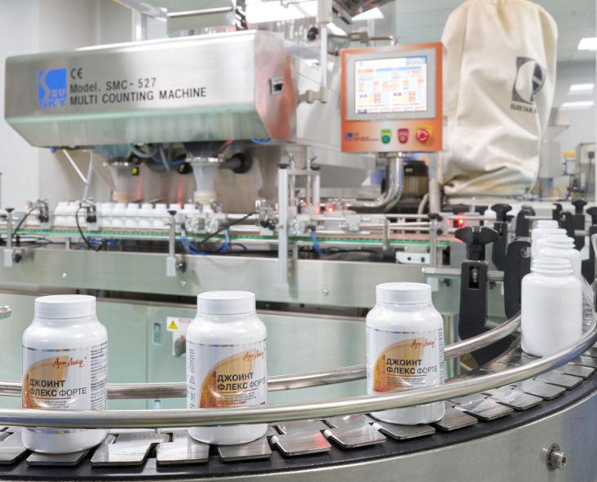
NEW OPPORTUNITIES FOR YOUR HEALTH

Slide 2
Health is like a Mountain Top, which everybody Must conquer by himself
Today we are increasingly thinking about the opportunities for active living at any age and the importance of preventing common diseases. The healthy lifestyle, including eutrophy (good and correct nutrition), came out on top.
It has been scientifically proven that even a carefully designed diet program is not always able to provide the body with all the elements, which are necessary to maintain a high level of health. In addition, adaptive capacity and opportunities of human reduce polluted environment, stresses and various types of radiation.
15%
On the organization of medical services
The state of human
health depends on:
15% on genetic properties
70% on the nutrition and lifestyle

Slide 3
^{ARTLIFE TODAY}
is a fast growing, high-tech production group integrating a variety of innovative businesses and successfully implementing them in the pharmaceutical, food, agricultural and other industries
^{Artlife Group:}
^{Artlife (Tomsk)}
^{Artlife Techno (Yurga)}
^{Artlife Ukraine (Mykolaiv)}
^{Artlife India (Noida,UP)}
^{Sibfarmkontrakt (Tomsk)}
The object of Artlife company: manufacture the products, which help people live a long, healthy life and stay active and beautiful

Slide 4
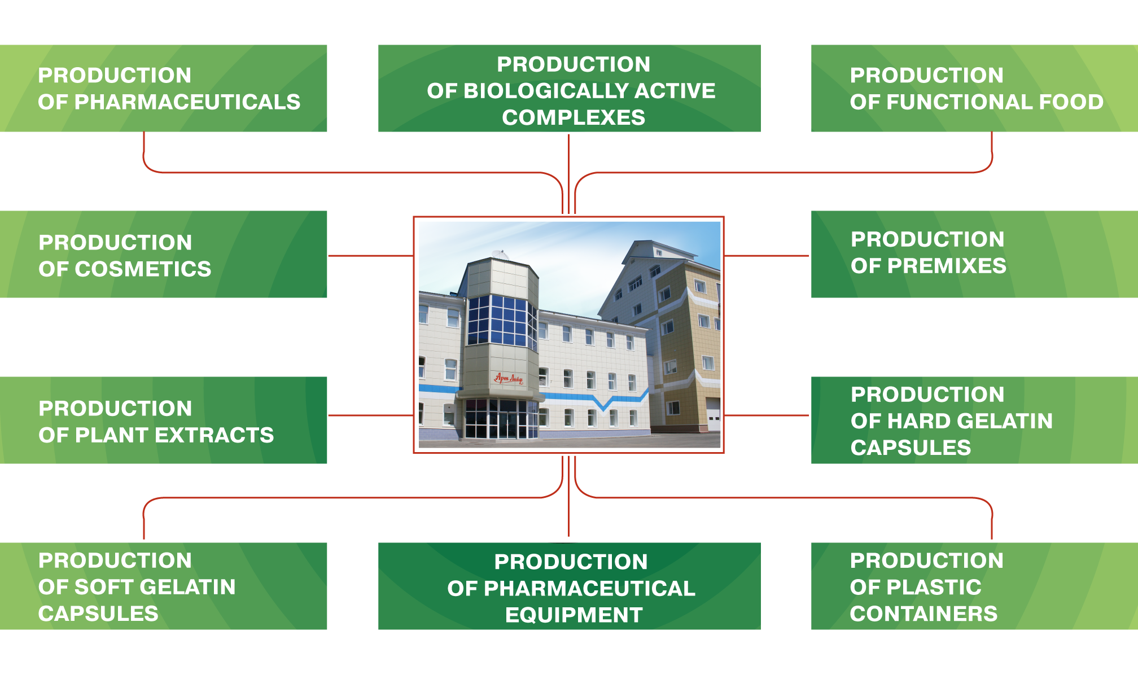
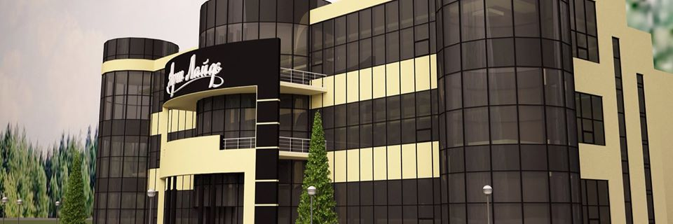
^{AREAS OF PRODUCTION}

Slide 5
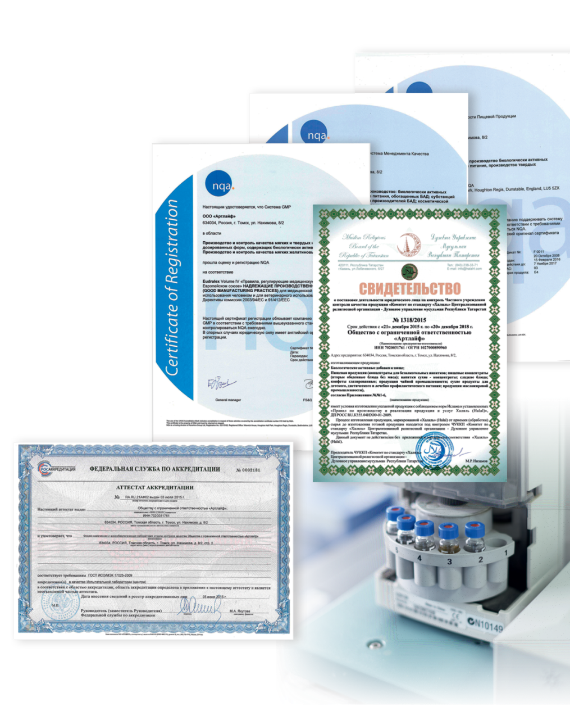
^{QUALITY MANAGEMENT SYSTEM}
^{CERTIFICATION OF THE COMPANY}
Artlife was one of the first companies certified for compliance with international standards, such as ISO 9001, ISO 22 000, and GMP.
In 2011, the Company obtained the international Halal certificate.
4,650 m2 of qualified clean rooms are fitted on the basis of the GMP requirements.
^{ACCREDITATION OF LABORATORIES}
The Testing Laboratory of the Quality Control Department is accredited in the National Accreditation System of the Russian Federation.
Physicochemical and Microbiological Laboratories are responsible for quality and safety control at all stages of the product life cycle, starting from selection and control of incoming raw materials.
● A well-balanced unique base for analyzing biologically active substances: atomic absorption spectrometer, infrared spectrometer, liquid and gas chromatographs, and other devices
● The laboratory is accredited for more than 1,000 indicators
● All Product licensed and passed by FSSAI Norms.
More than 1,300 types of raw materials are used in production
All raw materials are checked for purity

Slide 6
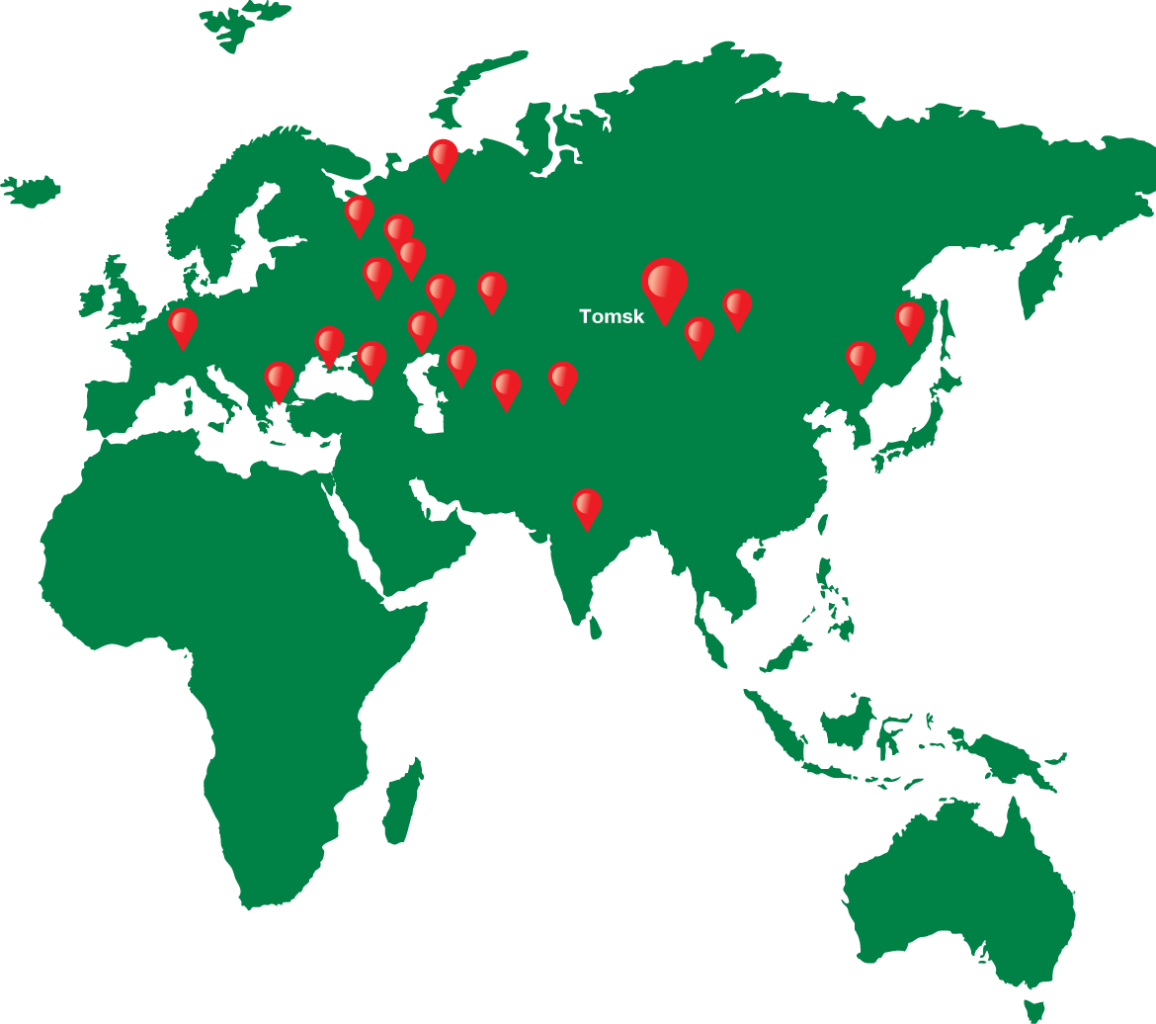
^{GEOGRAPHY} ^{OF PARTNERSHIPS}
^{ARTLIFE TODAY}
— service centers in more than ^{400 cities of Russia.}
— offices in more than 25 countries ^{around the world;}
— official certification of products ^{in all countries of presence.}
• Every year it opens more than ^{20 dealerships in Russia.}
• Every fifth Russian family knows Artlife products.

Slide 7
ADVANTAGES OF ARTLIFE’S BIOCOMPLEXES
GMP
Formulations
Technologies
Quality standards
Contains the elements in optimal quantities and suitable for optional digestion.
Preference is given to nutrients of plant origin.
Is taken into account the needs of Indian population for macro- and micronutrients.
All of the mixtures required for food supplements are manufacturing in Russia, all of the equipments comply with high world standards.
Every stage of production in India will be controlled by Russian experts.
Artlife company has a pharmaceutical license and manufactures products as per GMP standards.
composition and formulation of all of the supplements complies with the requirements of Indian Regulations.

Slide 8
The product range of the Artlife company let you select useful products and individual programs for yourself and your loved ones
To normalize the state of nutrition, control your weight and help you to look beautiful
To increase body's defenses and provide high resistance to negative and adverse environmental factors
To prevent common diseases

Slide 9
OLEOPRENS
A new level of body protection
Natural bio complex based on unique Abies spectabilis leaves micro powder.
Improve regeneration processes
Provide aimed action (heart, liver, nervous system)
Effective and safe with continuous intake

Slide 10
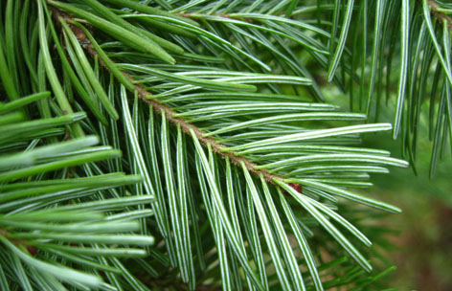
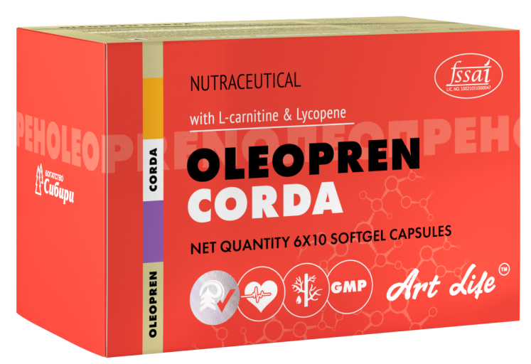
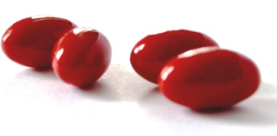
AN ACTIVE SUPPORT FOR HEART MUSCLES
A cardio protector of new generation on the basis of micros powder of Himalayan fir.
This bioactive complex helps to protect and restore the cell membrane of cardio myocyte at different damage levels, activates the processes of protein synthesis, improves the function of immune system, and protects from oxidative stress.
Restores the myocardial cell membranes and vessel walls.
Stimulates the regeneration of heart cells
Protects from negative impacts of free radicals
Provides nutritional support for heart muscles
Normalizes cholesterol level
Provides prophylaxis of myocardial infarction

Slide 11
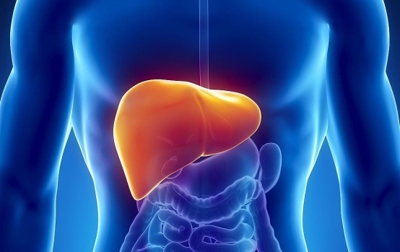
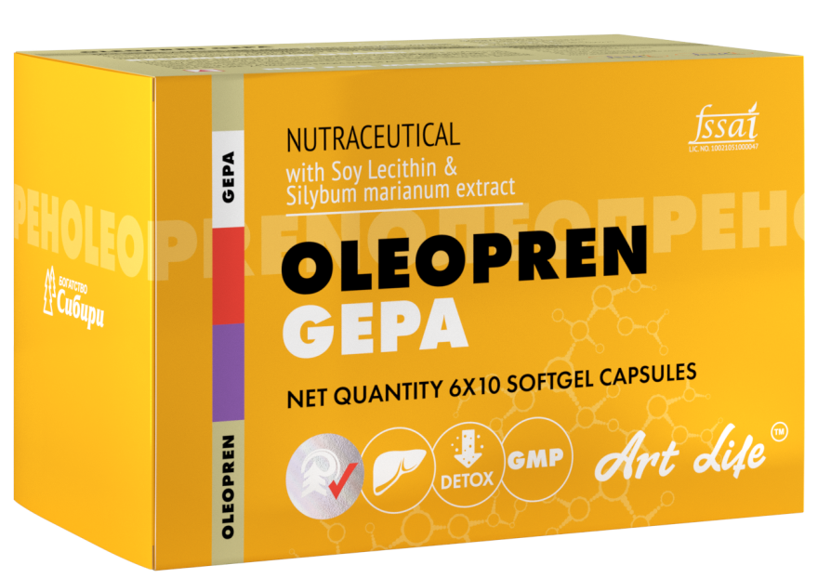
^{AN ACTIVE SUPPORT FOR LIVER}
A hepa protector of new generation on the basis of micros powder of Himalayan fir.
This product helps to protect and restore the cell membrane of hepatocytes at different damage levels, activates the processes of protein synthesis, improves the function of immune system, and protects from oxidative stress.
Removes toxic substances from the liver
Restores the structure of liver cells
Reduces inflammatory processes in the liver
Enhances resistance of liver to the toxins and other
adverse factors
Improves the state of liver after infections.

Slide 12
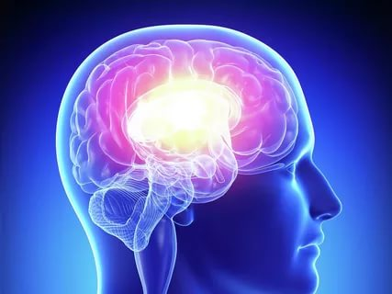
^{AN ACTIVE SUPPORT FOR BRAIN}
A neuro protector of new generation on the basis of micros powder of Himalayan fir.
This bioactive complex helps to protect and restore the cell membrane of brain neurons and peripheral nervous system at different damage levels, activates the processes of protein synthesis, and protects from oxidative stress.
Stimulates brain activities
Helps improve memory and attention
Provides resistance to the stresses
Increases endurance during the physical
and mental loads

Slide 13
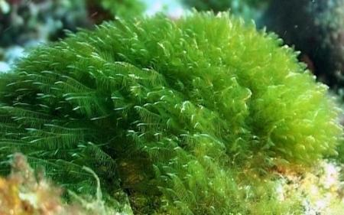
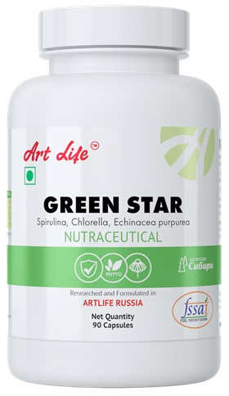
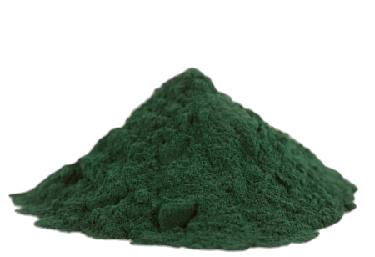
^{DAILY SUPPORT}
GREEN STAR is a unique bioactive complex with marine algae, which has general health-improving effect. Spirulina has a positive effect on the intestinal microflora, improves function of the gastrointestinal tract, intestinal peristalsis and normalizes metabolic processes in the body. Chlorella is high in chlorophyll, which is an effective disinfectant of natural origin, has antiseptic and restorative effect. Pectin improves the function of digestive system. Echinacea supports immune system.
Prevention of iodine deficiency
Improves function of gastrointestinal tract
Helps strengthen immunity system; increases body's resistance to acute and chronic diseases, high physical loads and stresses.
Improves skin condition

Slide 14
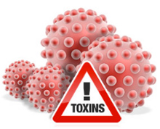
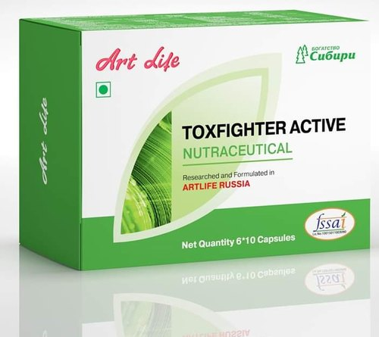
^{DAILY SUPPORT}
TOXFIGHTER ACTIVE is a universal enterosorbent, which is made on the basis of plant components, that helps to neutralize the effect of toxins and by products of metabolism. Apple pectin has astringent and wraparound effect, and protects mucosa of gastrointestinal track. Papain enzyme helps more to completely digest food and improves digestive processes. Spirulina and inulin help remove toxins from
the body and provide necessary balance.
Body cleansing program should be performed 1-2 times in a year.
* Reduces toxic loads in the body
Improves functional state of gastrointestinal tract, liver and
pancreas.
* help to correct metabolic processes in body
Is recommended for the people, who live under adverse
environmental conditions

Slide 15
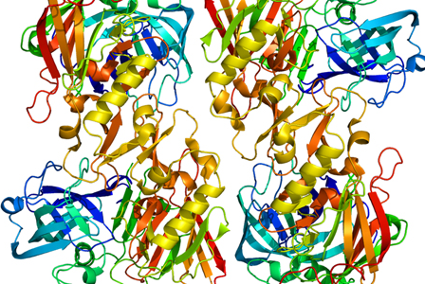
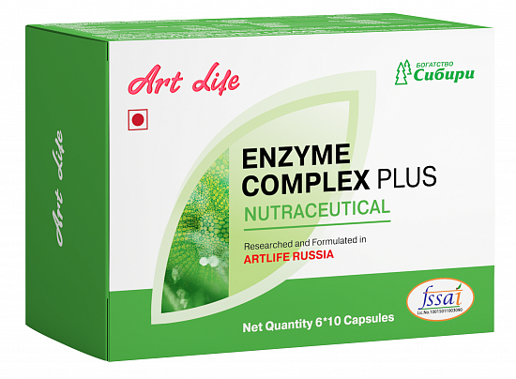
^{DAILY SUPPORT}
Enzymes speed up chemical reactions, improves splitting of fats, carbohydrates and proteins for the purpose of maximum digestion, optimizes anti-inflammatory response of body, has immune modulative effect, controls respiration and circulation processes. Zinc activates enzyme actions and protects against hypoxia.
Echinacea and licorice enhance immune modulative
effect, antibacterial and anti-inflammatory effects of
The enzymes.
Helps more to completely digest food.
Speeds up removal of toxins from the body.
Activates anti-inflammatory response of body.
Increases the immunity and protects from oxidative stress

Slide 16
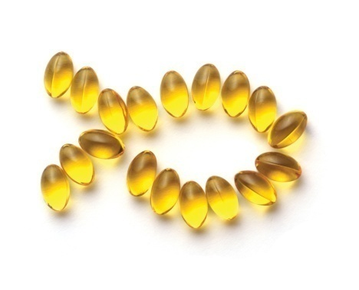
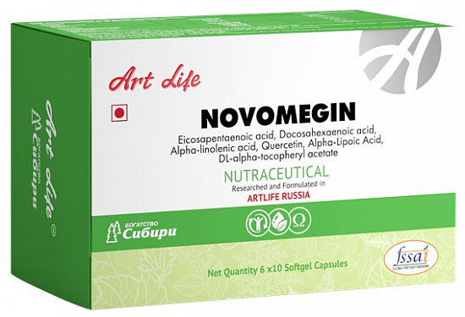
^{DAILY SUPPORT}
NOVOMEGIN is a source of polyunsaturated fatty acids, deficiency of which can adversely affect health status. Polyunsaturated fatty acids help to maintain a healthy cholesterol level, blood circulation and natural anti-inflammatory mechanisms of the body. Novomegin bioactive complex’s formulation is strengthened with quercetin and lipoic acid. Quercetin reduces vascular permeability and increases their elasticity. Lipoic acid has a high antioxidant effect and improves energy production in body.
Strengthens vessels
Prevents atherosclerosis
Increases body energy reserve

Slide 17
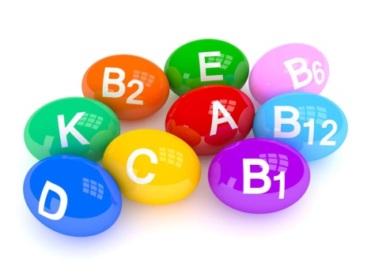
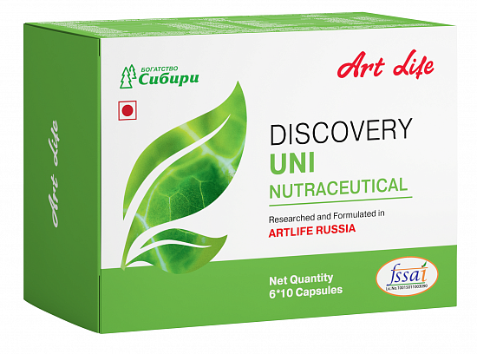
^{DAILY SUPPORT}
Taking DISCOVERY UNI bioactive complex helps reduce the consequences of malnutrition, adverse environmental conditions, reduce chronic fatigue, and support the functions of immune system. Vitamins are the essential part of human nutrition. Human body cannot synthesize vitamins independently and should receive them with food. Vitamins are taking part in a large amount of our body reactions, our organism cannot function without them. Macro- and microelements should be present in our diet. Even minor deviations in the mineral content from
the norm could cause heart disease.
This complex has a general health improving effect
Protects body from stresses and bad ecological conditions

Slide 18
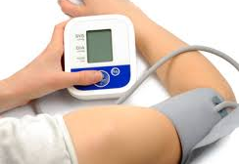
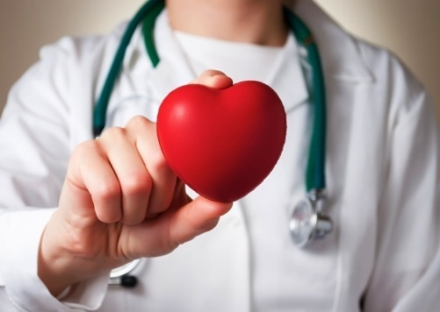
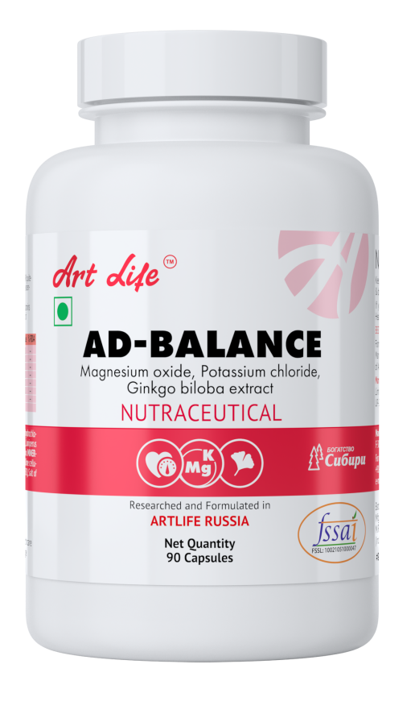
^{CARDIAC SUPPORT}
AD-BALANCE bioactive complex contains plant components with high antioxidant and vessel constructive effect. Gingko biloba extract and quercetin strengthen the vessel walls. Microelements of potassium and magnesium take part in vital processes of cardiovascular system; maintain elasticity of blood vessel walls, prevent thrombosis, and regulate the course of metabolic processes. Hops and mint relieve stress.
Help to maintain blood pressure within normal limits
Has a positive effect on cardiovascular system.

Slide 19
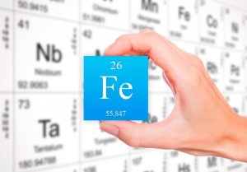
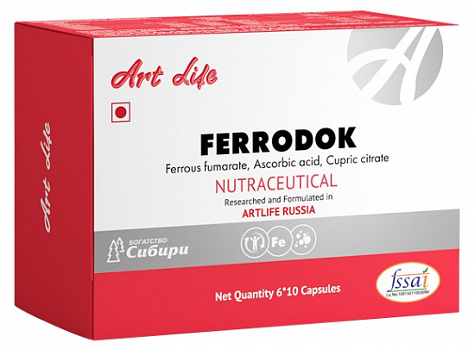
^{IMPORTANT MICROELEMENTS}
Iron is a very essential microelement that has key importance for the production of red blood cells and special enzymes. The need for iron rises in the period of growth and human development, in case of chronic fatigue and increased
physical loads. FERRODOK bioactive complex helps to
fill the deficiency of important microelements. Copper,
iron, zinc alongside with the complex of amino acids and
vitamins are essential for providing oxygen for blood
and muscle tissues.
Helps to maintain energy and health to muscles, brain, immune system and metabolism,
It is useful in case of chronic fatigue, stress, high physical loads, beriberi and unbalanced diets

Slide 20
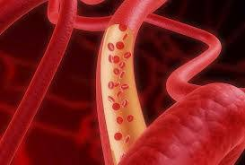
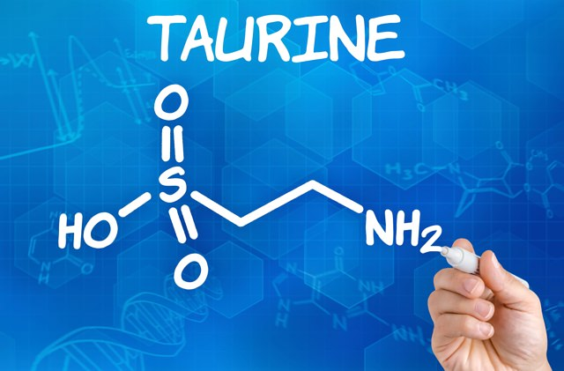
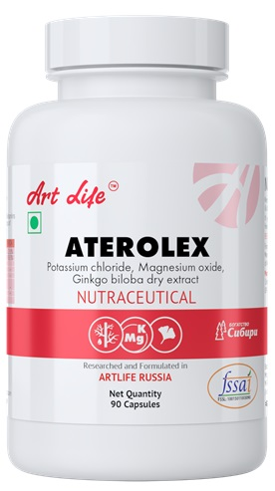
HELPS TO PREVENT ATHEROSCLEROSIS
The components of ATEROLEX bioactive complex help to maintain the normal state of the arterial bed. Vitamin C strengthens the blood vessel walls, B vitamins are essential for reactions of homocysteine metabolism. Taurine is essential for the synthesis of bile acids, which remove excess cholesterol from the body. Gingko biloba extract has an antioxidant effect, strengthens the blood vessel walls and improves microcirculation
Supports the functions of cardiovascular system

Slide 21
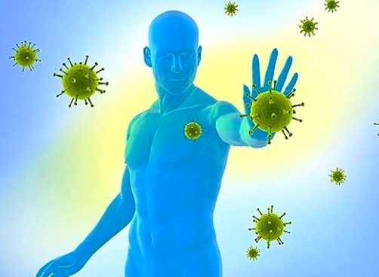
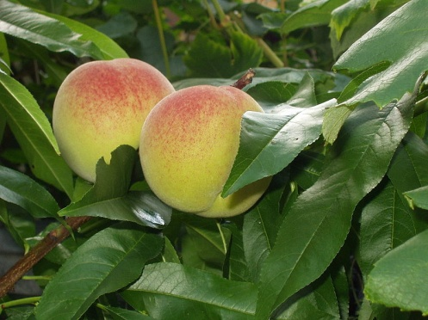
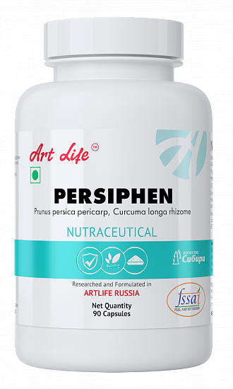
ANTIOXIDANT PROTECTION OF THE ORGANISM
PERSIPHEN effectively protects the body from free radicals, thereby preventing the development of a large number of pathological processes. Prunus persica pericarp is a natural complex compounds, which have a high ability to block free radicals. Vitamin C, vitamin Е, Beta-Carotene are intensifying the antioxidant effect, and also have a beneficial effect on the vessels. Curcuma longa rhizome has antioxidant effect, slows down the aging process, supports liver functions, has an anti-inflammatory and antimicrobial effects, and reduces the risk of oncological diseases.
Improves the general state of organism
Activates the immune system
Improves the state of vessels

Slide 22
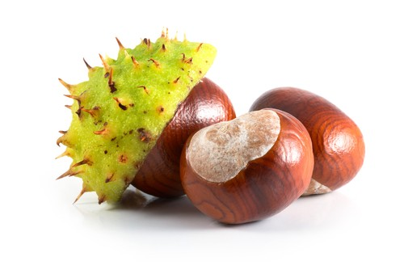
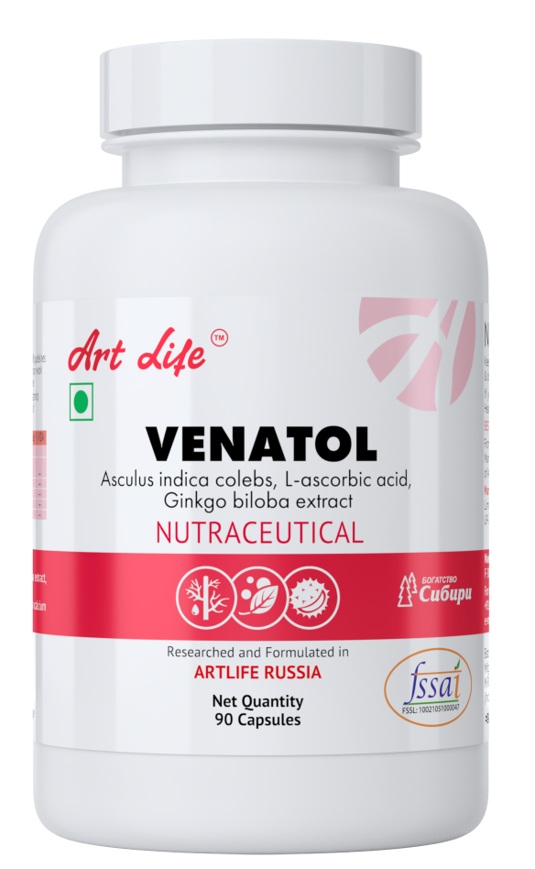
^{VEIN TONING}
VENATOL It is a clinically proved complex for prevention of varicose veins! Horse chestnut improves the integrity of the vascular wall, has a positive effect on the permeability of capillaries, and has a vein tonic effect. Bromelain reduces the level of inflammatory reaction, prevents blood vessels from becoming narrowed. Hesperidin, rutin and quercetin are powerful antioxidants, help strengthen blood vessels and increase the integrity of collagen.
Has vein toning and antioxidant effect
Is recommended for people with a predisposition to varicose veins (who work at a sedentary or standing job, people with excess weight, sedentary lifestyle, smoking, in case of hormone intake and etc.)

Slide 23
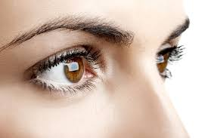
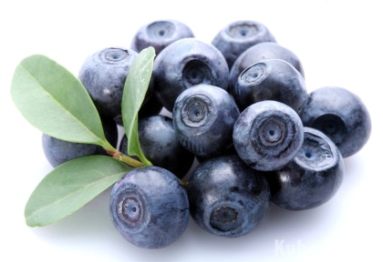
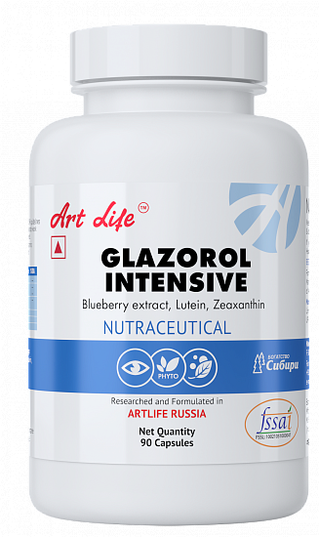
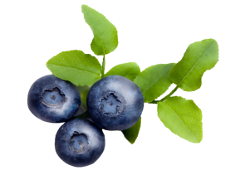
^{VISION SUPPORT}
GLAZOROL INTENSIVE composition provides comprehensive and versatile protection of your vision. Natural pigments (zeaxanthin, lutein) protect retina from aggressive particles of light spectrum. Blueberry, quercetin and ginkgo biloba have antioxidant effects, help to improve microcirculation. Beta-carotene improves light perception and eye adaptation to darkness. The natural amino acids: L-taurine and L- cysteine, as well as vitamins provide nutritional support.
Reduces visual fatigue syndrome (while reading, working with computer, driving and etc.)
Prevention of age-related changes in eyes

Slide 24
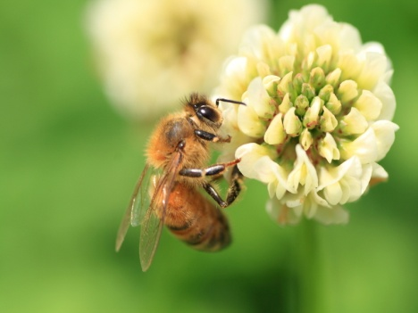
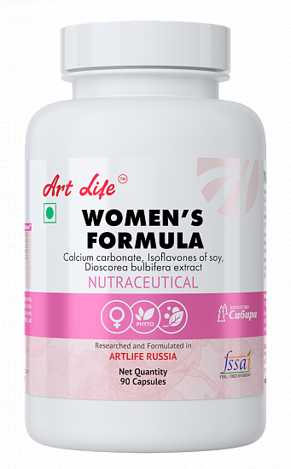
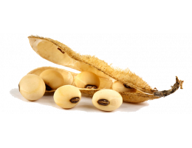
^{CARE OF WOMEN'S HEALTH}
WOMENS FORMULA contains natural substances, which help to maintain the balance in female body and alleviate the symptoms, that occur during menopause (mood swings, increased sweating and migraines). Natural soy isoflavones are essential for supporting female body. The needed amount of isoflavones is difficult to provide in the conditions of routine food. Plant extracts, vitamins and microelements help to maintain the normal metabolism in female body.
Helps to prevent hormonal imbalance in the female body
Provides support during menopause

Slide 25
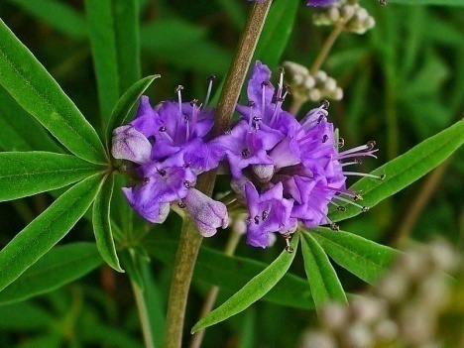
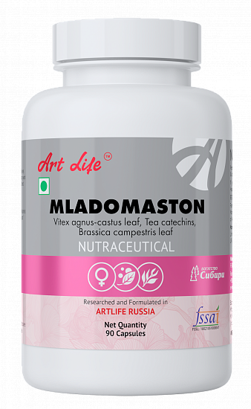
SUPPORT OF THE FEMALE REPRODUCTIVE SYSTEM
MLADOMASTON is intended to normalize exchange of estrogens and prevent hormone dependent diseases of the female reproductive system. Brassica campestris leaf stops the development of neoplastic process at any level.
Vitex agnus-castus leaf reduces the symptoms of menopause and premenstrual syndrome. Tea catechins и Resveratrol are the strongest antioxidants, block neoplasm, stop the development and progression of cancer cells. Isoflavones prevent age-related hormonal disorders.
Normalizes endocrine profile
Helps to prevent oncological diseases

Slide 26
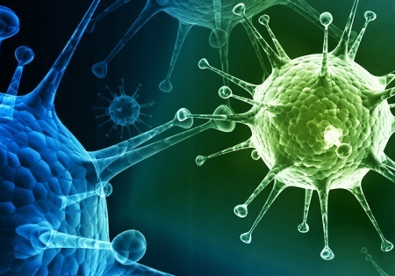
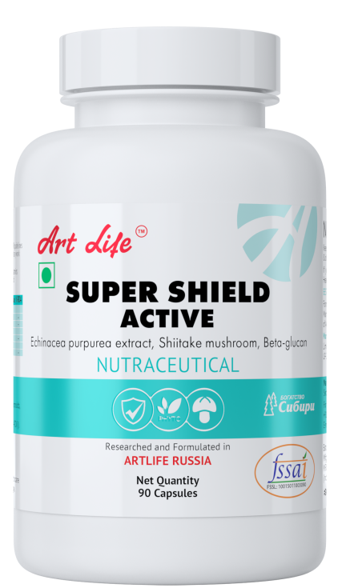
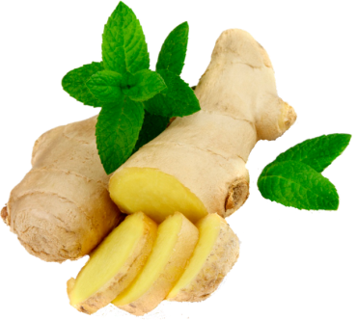
^{SUPPORT}
^{FOR IMMUNITY}
SUPER SHIELD ACTIVE is a unique combination of natural components, which is directed to the effective correction of immune system dysfunctions. Beta-glucan is a polysaccharide from mushrooms and yeast which increases nonspecific and specific immunity by activating immune cells. Shiitake ginger and Echinacea increase resistance to infections, strengthen immunity, activate metabolic processes in liver cells. Ginger root has anti-inflammatory and antipyretic effect.
Has antiviral and anti-inflammatory effect.
Helps strengthen immunity.
Is recommended for use as a part of complex therapy and prophylaxis of acute respiratory diseases.
Increases resistance to herpetic and other viral infections.

Slide 27
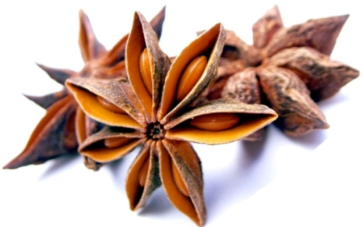
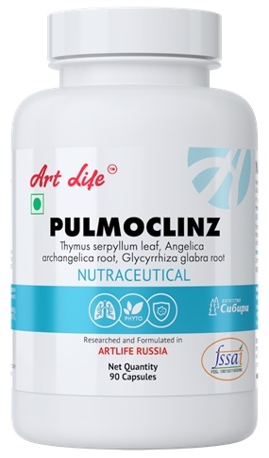
^{RESPIRATORY PROTECTION}
PULMOCLINZ contains plant extracts, which helps to reduce intensity of inflammation in respiratory track and improves well-being. Thyme, angelica, anise fruits, licorice and ginger have antibacterial effect, facilitate coughing, soften mucous membrane and help to get rid of phlegm. Bromelain enhances anti-inflammatory immune response. Quercetin has antioxidant effect, improves microcirculation, and increases immunity in case of respiratory diseases.
Helps reduce inflammation in respiratory tract
Helps strengthen immunity
Protects respiratory tract from harmful effects (smoking, allergens, harmful production factors, bad ecological conditions)

Slide 28
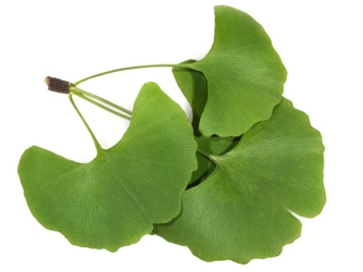
^{ACTIVE BRAIN WORK}
MRISE is a natural bioactive complex; it helps to support cognitive functions (memory, concentration and etc.). Gingko biloba strengthens the blood vessel walls, improves microcirculation and venous outflow from the brain. Ginseng has a tonic effect, increases the workability. Lecithin provides nutritional support to the brain. Vitamins stabilize the energy metabolism and regulate the molecular processes underlying memory and concentration. L-tryptophan as an amino acid provides a positive effect on emotional state.
Enhances general workability, concentration and memory, especially in case of overtiredness and fatigue
helps to slow down processes of age-related impairments of cognitive functions, vision, hearing

Slide 29
TRANQUILITY OF THE NERVOUS SYSTEM
NSTABIL contains plants with a mild soothing effect. Hops and valerian improve the functional state of central nervous system, improve sleep quality. Mint and St. John’s wort help to relieve spasms and are useful in case of mild migraines. L-tryptophan as an amino acid provides a positive effect on the emotional state. Vitamin B6 takes part in energy metabolism.
Has a mild sedative effect
Increases the workability, resistance to stress and high physical loads.
Improves the process of falling asleep in case of mild insomnia

Slide 30
^{PARASITISM PREVENTION}
ARTEMISIN-M contains a combination of plant substances, which provide sanitation and cleansing of gastrointestinal tract from helminthic invasions. Wormwood contains a high amount of bitterness due to which it has an anthelmintic effect, it helps cleanse the body from toxins and parasites. Garlic, cloves and St. John's Wort have strong antiparasitic, choleretic and spasmolytic effect. Cassia helps to remove toxins.
Cleanses gastrointestinal tract
Prevent parasites
Reduces toxic loads from body

Slide 31
SUPPORT OF THE DIGESTIVE SYSTEM
GALM-MAXI complex helps to maintain digestive track health. Plant components (flax, chamomile, valerian, licorice) have a mild antacid, anti-inflammatory and enveloping effect, increase protective properties of mucous membrane of the gastrointestinal tract, stimulate regeneration processes, help to restore in case of functional disorders of the gastrointestinal tract. Magnesium carbonate / magnesium oxide have a mild neutralizing effect in reference to hydrochloric acid of gastric juice. Papain is a powerful catalyst for the most important metabolic processes.
Support for digestive system
Helps reduce gastric irritation

Slide 32
^{DAILY SUPPORT FOR}
^{A HEALTHY LIVER}
The proper functioning of liver is necessary for general health state of body. HEPAR FORMULA provides comprehensive support for liver function. Blessed thistle, lecithin and milk thistle are traditionally used for regeneration and protection of liver cells. Turmeric has an antiseptic effect. L-methionine activates natural process of detoxification. Inulin improves digestive processes, helps to grow useful micro flora in the intestines.
Daily support for a healthy liver
Activation of detoxification and regeneration processes.

Slide 33
^{HELPS URINARY TRACT}
PHYTOREN is a combination of cleansing and diuretic herbs, specially designed to prevent stagnant phenomena in the kidneys and help them to eliminate toxins. The moraine root has diaphoretic, diuretic, antispasmodic effects. Its effect is enhanced by the plants with high antiseptic effect, such as cranberry and junipers. Potassium and magnesium help restore acid-base balance in the urinary tract.
Supports kidney cleansing and detoxification
Helps to restore pH balance in the urinary tract

Slide 34
^{PROVIDES HEALTH}
^{SUPPORT IN}
CASE OF SUGAR DIABETES AND METABOLIC SYNDROME
The composition of GLUCOSIL NORMA bioactive complex has a positive effect on the metabolic processes in body. Taurine improves metabolic processes in the heart, liver, retina and other organs and tissues; it has also an antioxidant effect. It increases sensitivity of tissues to insulin. Bean shells extract helps to control the level of carbohydrates, thereby supports to maintain a healthy body weight. Garcinia helps to control appetite. Rutin and quercetin strengthen the vessels.
Helps to maintain a healthy body weight
Helps to strengthen vessels

Slide 35
SUPPORTS THE FUNCTIONS OF ENDOCRINE SYSTEM
The composition of TBALANCE bioactive complex is balanced and consists of a number of vitamins, amino acids and microelements, which are providing a normal function of endocrine system. L-Phenylalanine and L-tyrosine are the most important substrates for a number of neurotransmitter and hormones. Iodine in iodate form is an integral part of the thyroid gland secretes, which regulate cellular metabolism and energy production.
Is a source of iodine and vitamins
Has a general health improving effect

Slide 36
SUPPORT OF THE LOCOMOTOR APPARATUS
CALCI-M contains vital macroelements and microelements in the most available form for the organism. Calcium is the basis of bone tissue and provide its strength. Magnesium, Zinc, Manganese, Boron and Chromium are taking part in the metabolic processes and are necessary elements for maintaining a healthy locomotor apparatus. Vitamin C, Vitamin Д3, Vitamin К2 and Chondroitin sulphate are providing the retention of structure and functions of bones, vessels and connective tissues.
Helps to activate osteogenesis
Speeds up the bone healing process after injuries and fractures, has a positive effect on the recovery process of the nearby joints

Slide 37
^{PERFECT NOURISHING OF JOINTS}
JFLEX FORTE contains natural chondroprotectors (Chondroitin sulphate and Glucosamine sulphate ), that compensate for insufficient supply of nutrients to the connective joints.Boswellia serrate extract and Ginkgo biloba extract reduce the intensity of inflammatory processes in joints. Rutin and Vitamin C are the antioxidant, which protect the connective tissue from destruction. Copper takes part in the forming process of collagen and elastin, which are the structural components of bones and cartilaginous tissue.
Has a general health improving effect on the organism
Stimulates the recovery process of cartilaginous tissue
Helps to reduce inflammatory processes in the connective tissue and also decrease the pain syndrome

Slide 38
^{A STRONG ANTIBACTERIAL EFFECT}
The food supplement CETRA COMPLEX is a safe herbal antibacterial general health improving remedy.
Contains 7 plant extracts, which have a strong antibacterial effect: Echinacea purpurea extract, Azadirachta indica, St. John's wort extract, Curcuma longa , Juglans regia (walnut) Leaf, Olea europaea Seed, Shiitake mushroom extract.
Enhances the body protective power
Is a reliable prophylaxis of colds, flu, food poisoning
Increases body tone and endurance

Slide 39
BURDOK-C (NORMALIZATION OF ALL KIND OF METABOLIC PROCESSES)
Burdok-C is a unique bioactive complex, which provides a comprehensive support for body functions, due to correct any kind of metabolic disorders and helps to maintain body’s natural balance. Cichorium intybus , Juniperus communis, Inula racemosa - root extract contains an important polysaccharide, known as insulin, which improves the digestion of useful elements, normalizes lipid metabolism and hemopoiesis, reduces sugar level in case of diabetes, and enhances the immunity. L-ascorbic acid takes part in the different metabolic processes in
Body, intensifies redox pro-cesses in body, improves the
antitoxic function of liver and helps increase body resistance.
Normalizes metabolism.
Enhances the immune system.
Improves functions of all of the body systems.

Slide 40
MULTIMEGIN - THIS COMPLEX HAS A GENERAL HEALTH IMPROVING EFFECT (FOR CHILDREN AND ADULTS)
The complex components which are indispensable omega-3 fatty acids decrease the blood cholesterol level, helps to prevent the development of atherosclerosis, are a constructional material for damaged cell walls, reduce the pain syndrome intensity and decrease the occurrence of chronic inflammation. Bioactive complex stimulates the restoration of vessels good state, improves functioning of the cardio-vascular system and activity of the organs of vision, favourably influences the metabolism providing resistibility to harmful effects and increase of the general tone of the human organism.
Flaxseed oil, used in “MultiMegin” supplement contains an important alpha linolenic acid Alpha linolenic acid (ALA) proper development of brain, organs of vision, sex glands, nerve impulse transmission, fighting against stress, brain activity, Elaboration of prostaglandin E, adjustment of arterial pressure and blood cholesterol level, purification of blood vessels, preserving moisture in the skin and hair Lutein and Zeaxanthin – nutrients for vision health care.

Slide 41
A PROBIOTIC COMPLEX FOR THE NORMALIZATION OF DIGESTION
In the human intestines, there are a lot of bacteria's, that help keep the digestive system healthy. When their balance is disturbed, the process of food digestion also will be disturbed. This balance disturbance may manifest as indigestion, loss of appetite, anaemia, frequent diseases and skin problems. Sometimes the imbalance of micro flora manifests itself as “leaky bowel syndrome”. In case of mentioned syndrome, vitamins and microelements are not absorbed and it may cause allergic reactions.
What may cause dysbiosis, taking antibiotics, intestinal infections, digestive tract diseases, poor nutrition, vitamin deficiency and food allergies.
Help in nutritional support for dysbiosis in adults and children 14+ years old.
The “leaky bowel” syndrome – increased
permeability of the intestinal epithelial barrier.
Immune correction.

Slide 42
M FORMULA - PROSTATITIS PREVENTION
The complex «M FORMULA» has an anti-inflammatory effect, prevents the development and progression of prostate adenoma, help to restores cellular structures of glandular tissue, improves potency, increases libido, improves immunity and the overall performance of the male body.
Support for reproductive health of men (number, sperm motility)
Help in normalization of hormonal background of the man
Prophylaxis and help in comprehensive therapy of prostatitis
Prophylaxis and help in comprehensive therapy of benign prostatic hyperplasia (adenoma)
Prophylaxis of prostate cancer.

Slide 43
Thank you for attention
Note:-These products are not intended to diagnose, treat, cure or prevent any disease.
NOT FOR MEDICINAL USE

