Slide 10
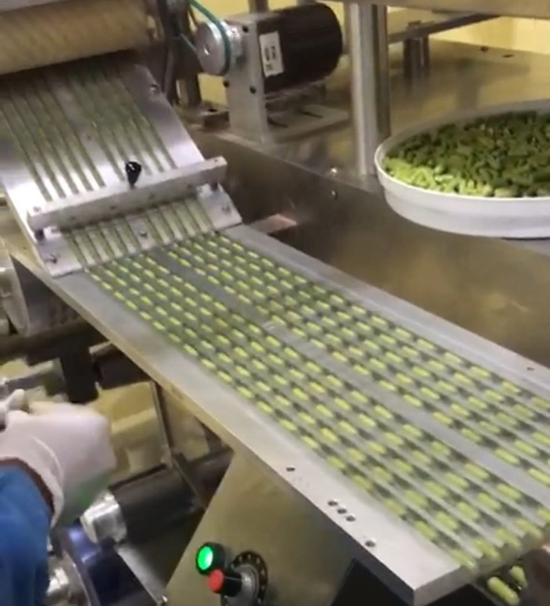
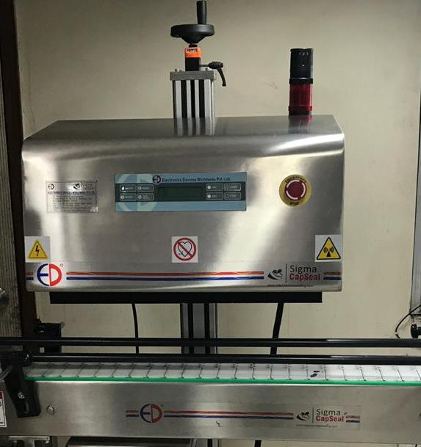
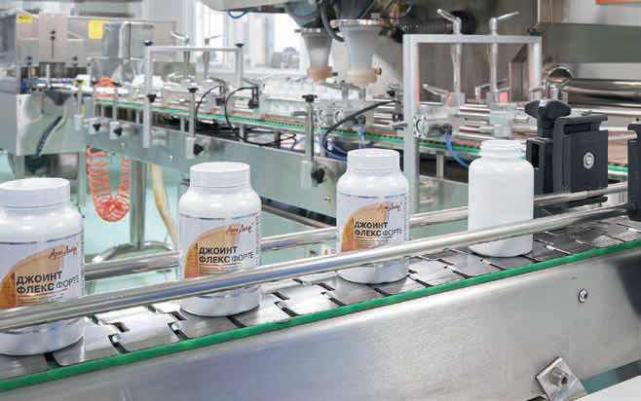
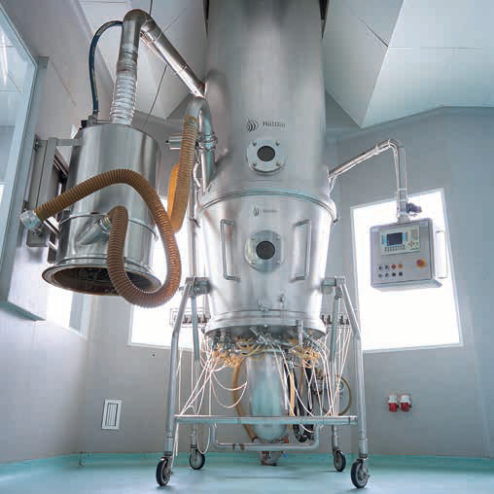
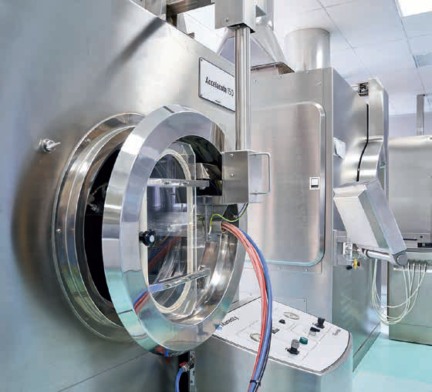
MODERN HIGH-TECH
EQUIPMENT
Fully automated production facilities are fitted with modern equipment supplied by reputed companies from all around the world, such as IMA (Italy), BWI Huttlin (Germany), Sigma(USA), KGK(Japan),India,China and Europe, as well as Artlife Techno (Russia).

Slide 14
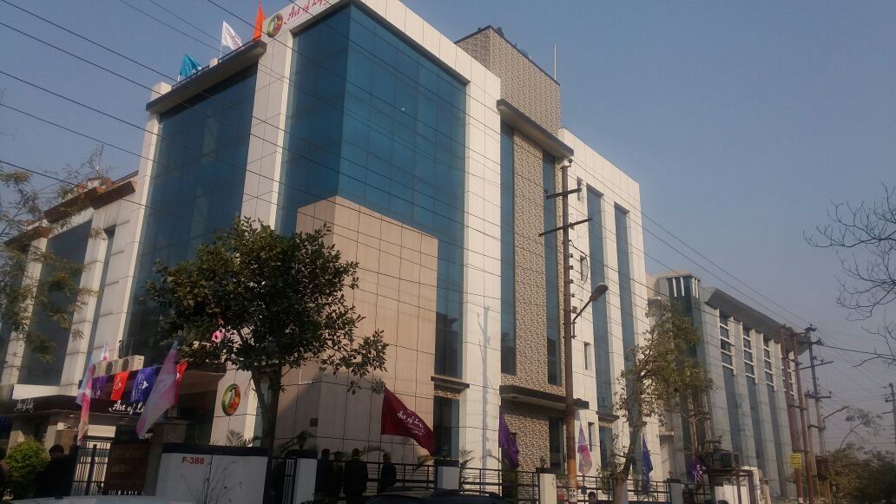
ARTLIFE INDIA
In 2009, Artlife opened its representative office in Delhi.
ARTLIFE INDIA, At the present time, the Company has opened more then 20 branches and service centres in different states of India. In 2016, it began the construction of a fully integrated production facility in Noida. Now, this is a separate production facility with the total area of 8000 sq.ft.

Slide 15
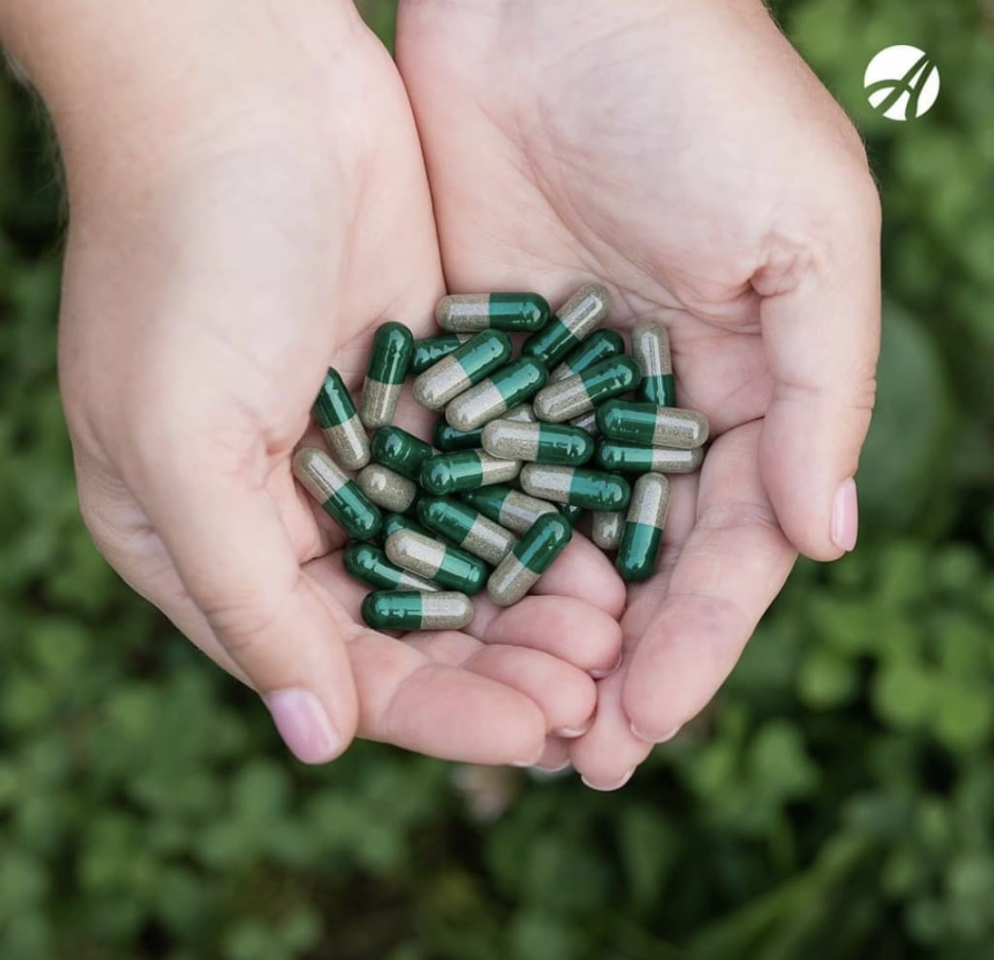
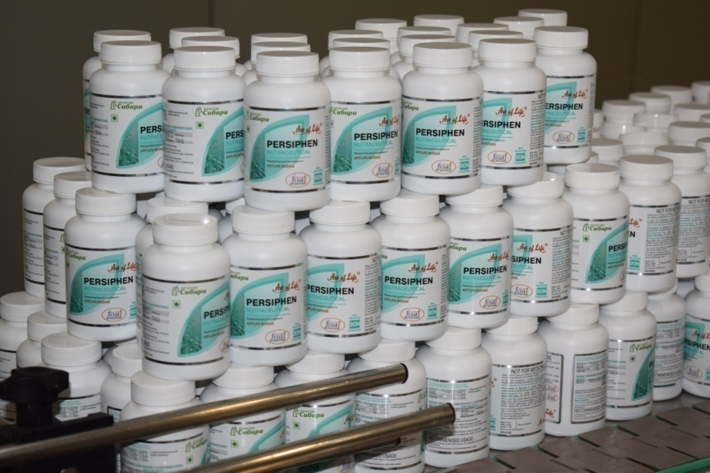
We are manufacturing already more then 30 biologically active supplements 20 functional foods.
Also We are working on many more products for future!

Slide 16
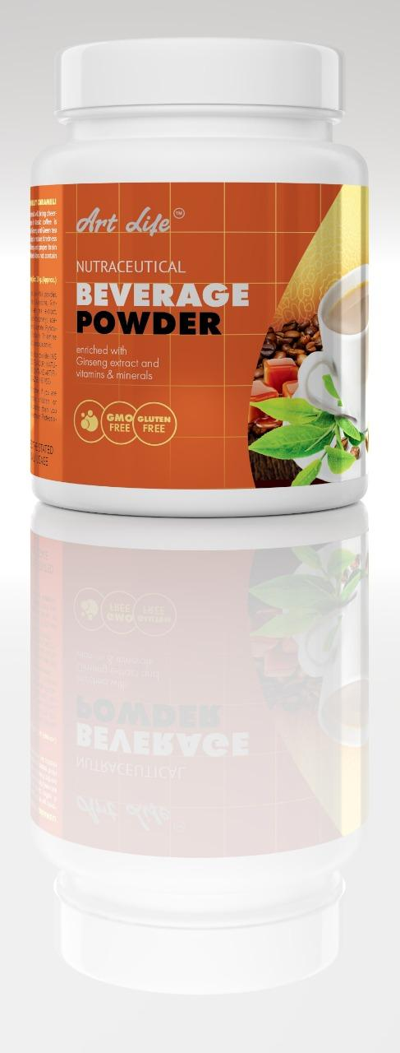
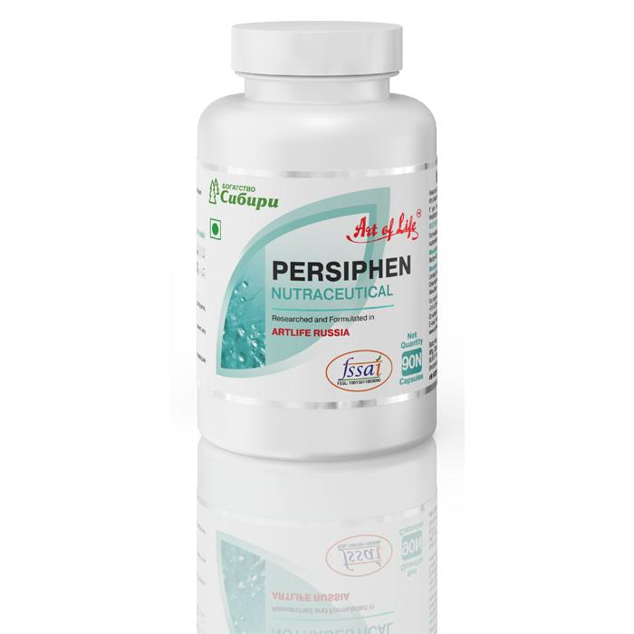
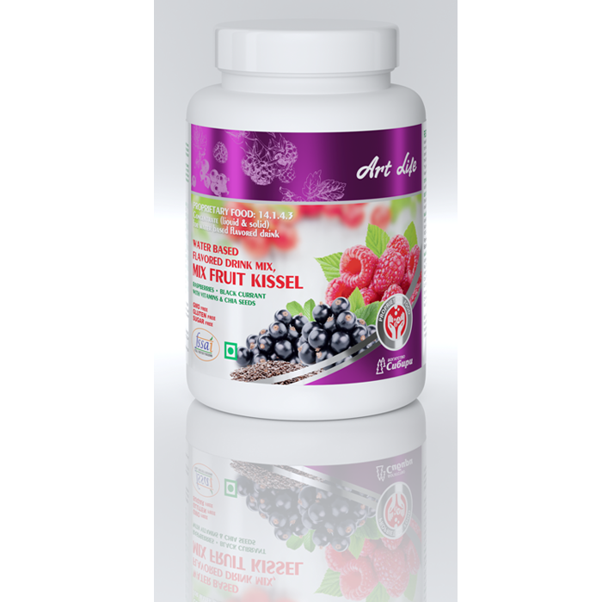
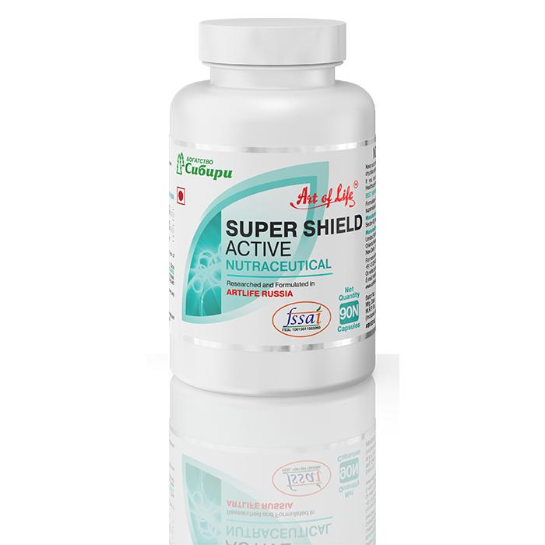
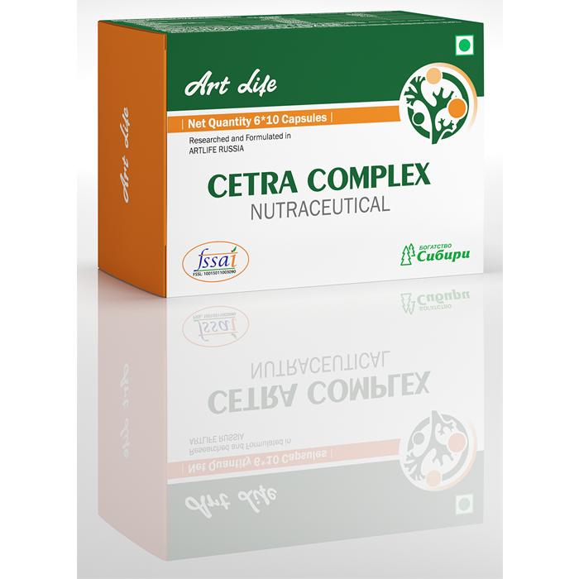
HIGH QUALITY PRODUCT RANGE
-Biologically active complexes
-Phytogels
-Food and Beverages
-Cosmetics

Slide 17
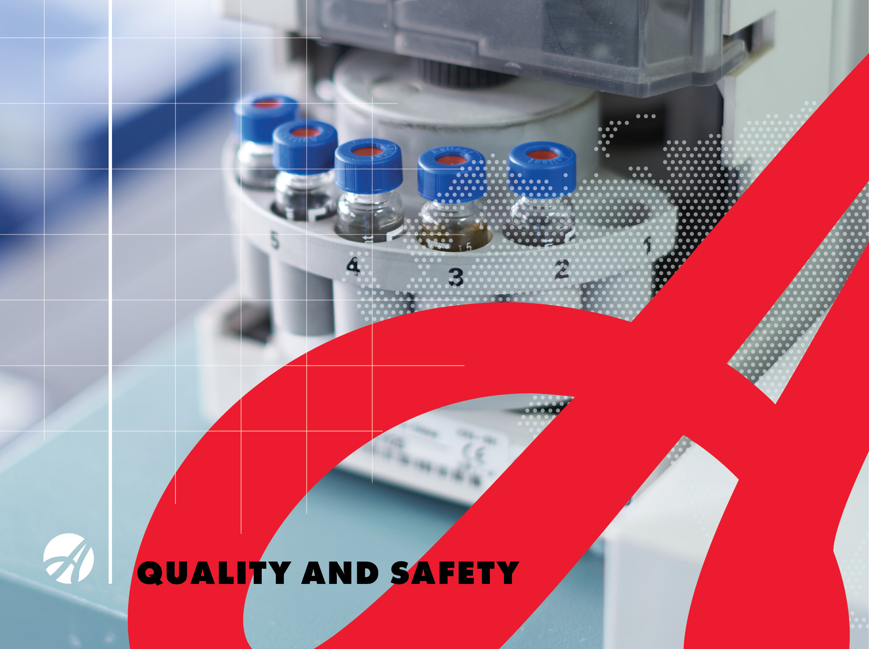

Slide 19
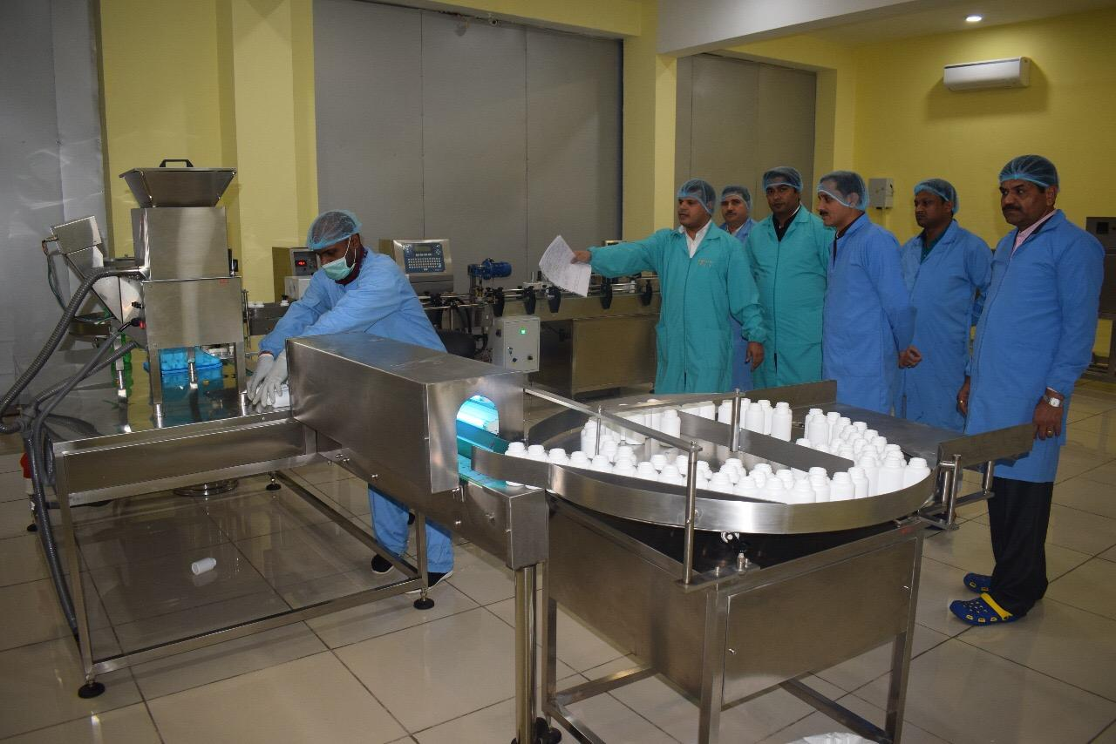
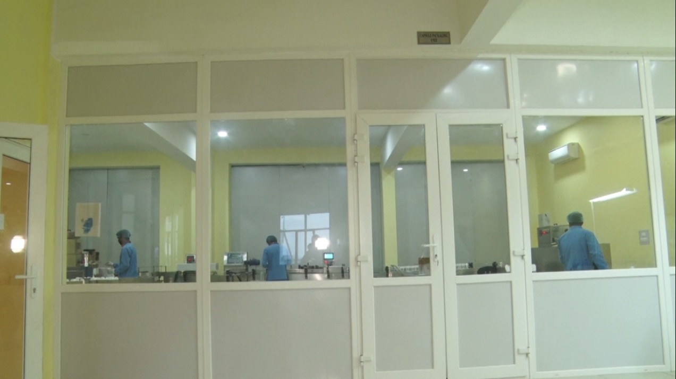
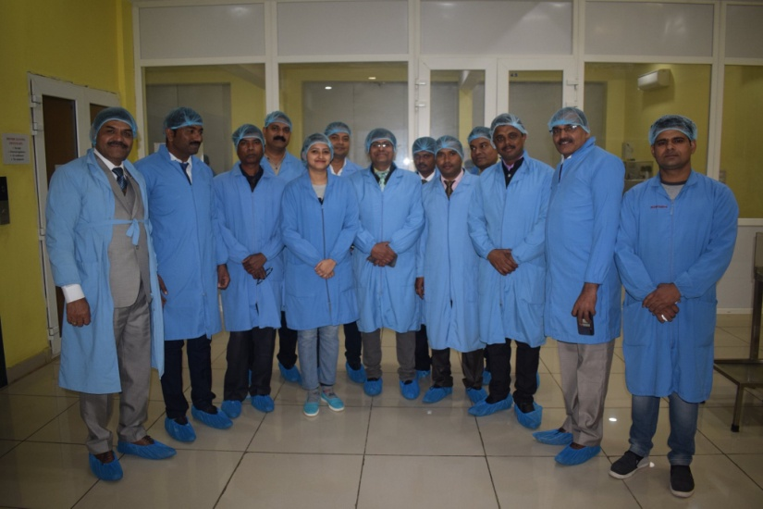
COMPLIANCE WITH THE INTERNATIONAL STANDARDS
Products of Company Artlife with satisfaction of vast research and scientifically Ensuring high level of productivity by implementing the necessary standards certificate like FSMS, compliance with FSSAI ,ISO 22000:2005 HACCP and other standards.
We also ensure the finished Products quality matches with the standards set down by management from time to time.

Slide 20
Food Safety Management System
Safety is the assurance given to the customer that the product will not cause any harm when consumed.
-Hazard Analysis and Critical Control Point (HACCP)
Personal Hygiene
Maintain & Cleaning Production Area.
Maintenance & Maintain equipments
-Pest and sanitization
Storage, Keep product out of danger zone.
Ensure medical examinations and training of employees.
-Product Testing
-Audit, Documentation & Records.
-Operations, Controls & Monitoring all Process.

Slide 21
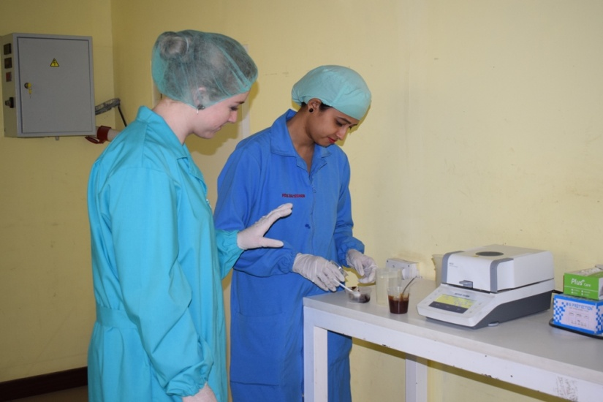
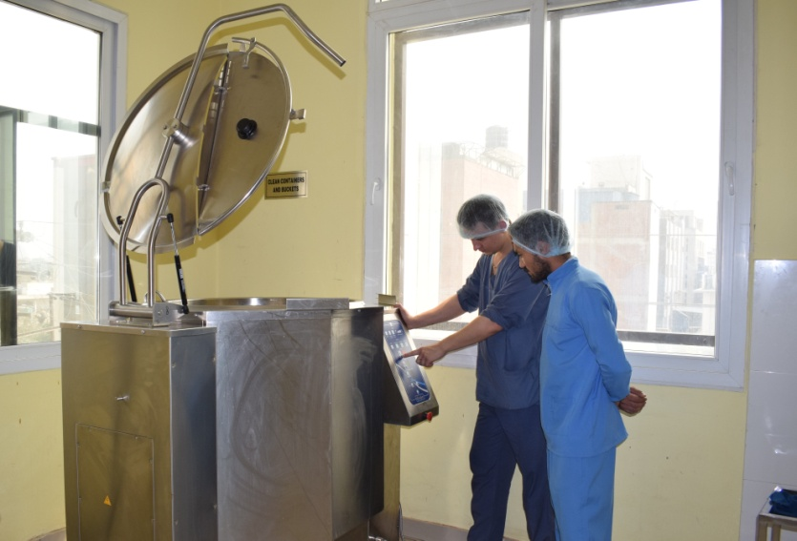
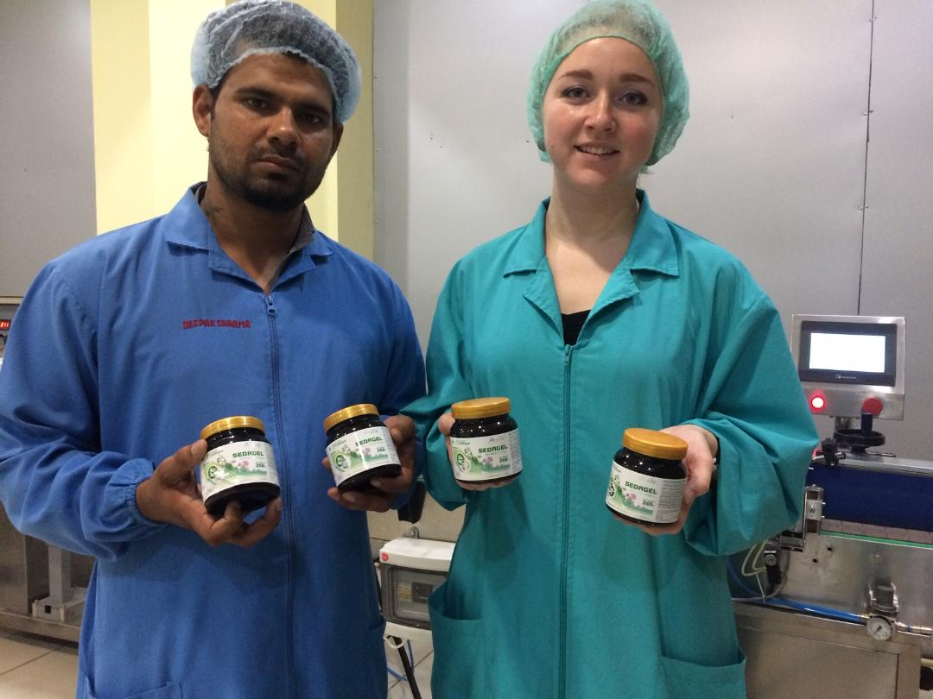
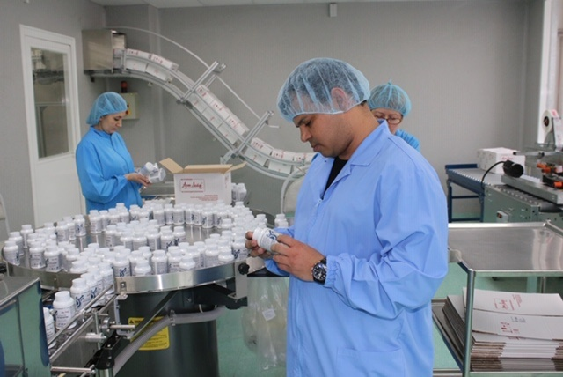
HIGH-SKILLED AND QUALIFIED STAFF
Our Production team were also been trained quarterly by conducting workshops, training and conference with the expert and quality team member from Russia.

Slide 22
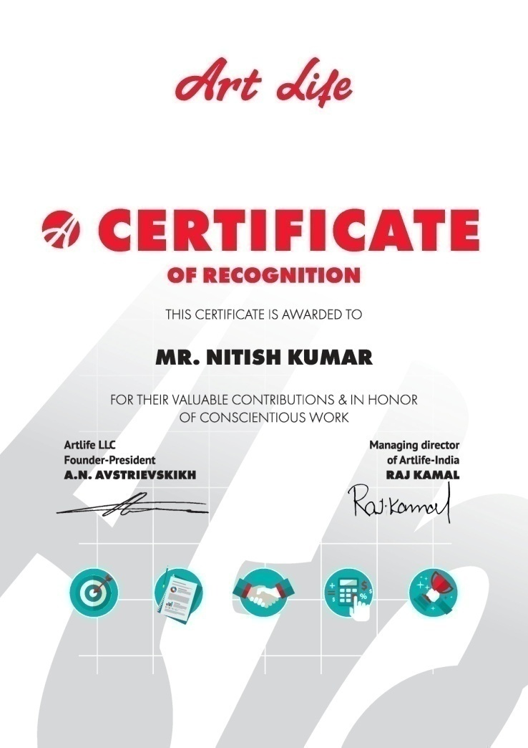
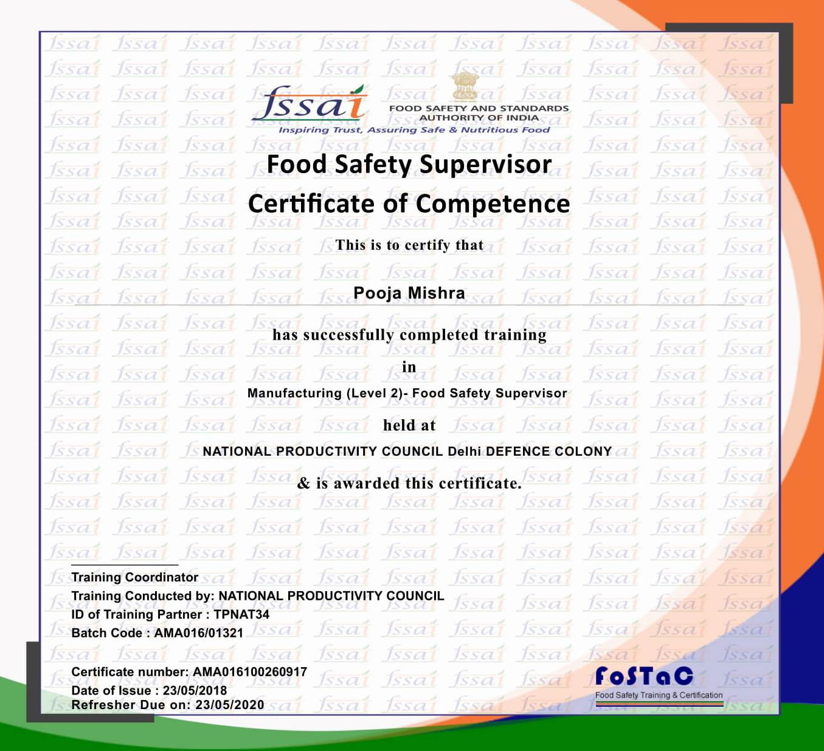
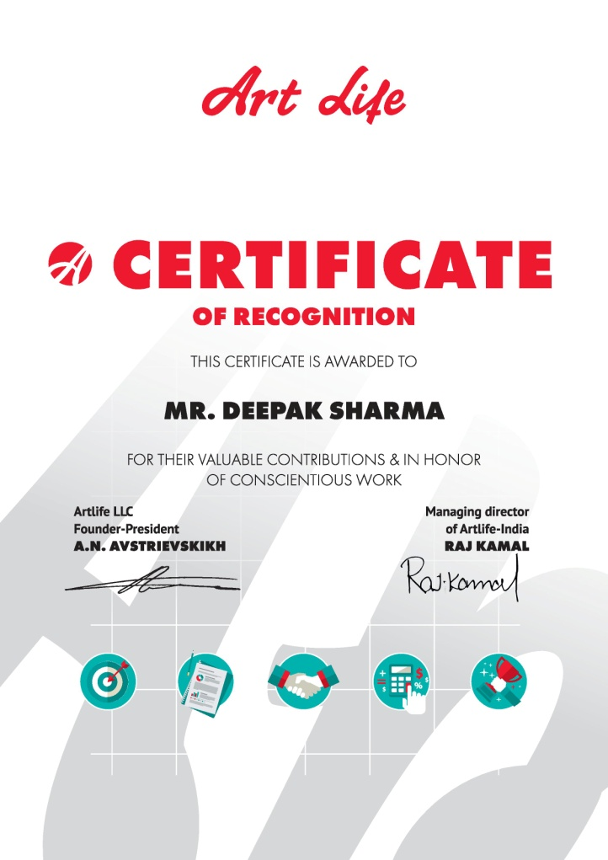
CERTIFICATES OF PROFESSIONAL TRAINING
Our Company Staff attained the seminar organised by FSSAI and special training from our head office Russia for better quality productivity.

Slide 23
Consumers worldwide are turning to dietary supplements as one part of their personal goal to lead healthier and more active lives.
Cashing in on the booming market for dietary supplements
How to choose a dietary supplement manufacturer
?

Slide 24
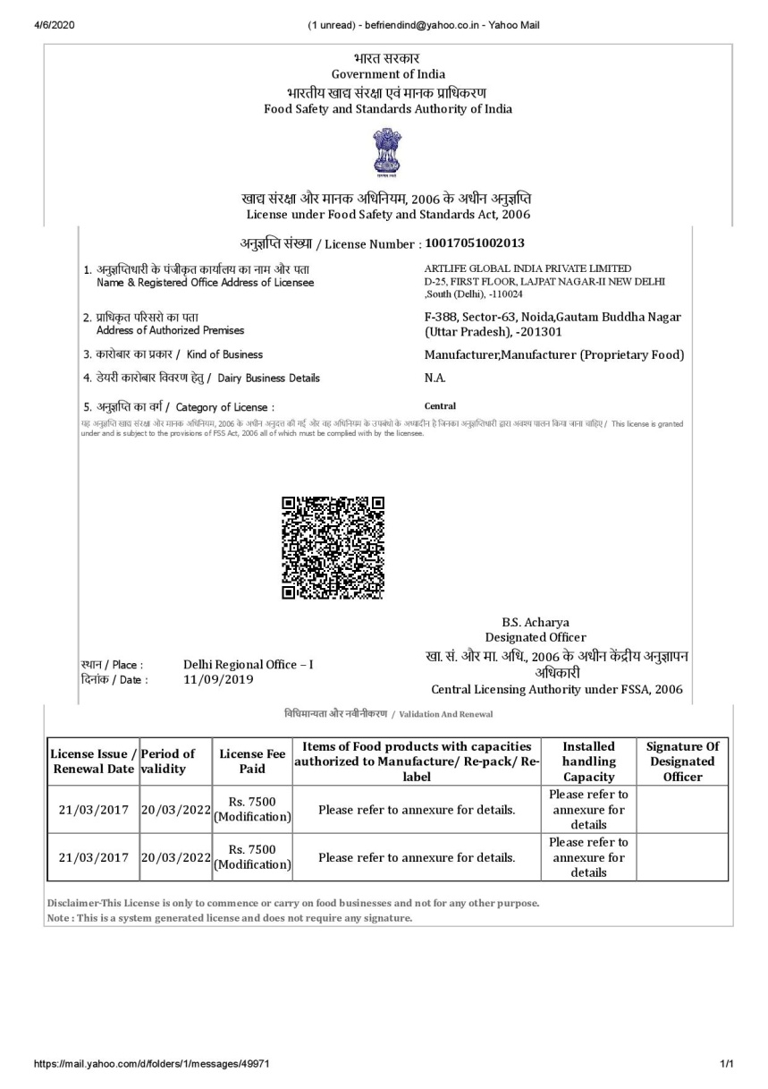
Registration of Products
In India all Food Supplement Products must under go FSSAI registration, during which the product is checked for the safety and content of biologically active substances. Also follow the Fssai Guidelines.

Slide 25
What should be indicated on the packaging or Labelling of a quality dietary supplement?
-The composition in order the weight or percentage of the substance.
-Detailed information of INGREDIENTS .
Properties and method of use, contraindications The words “NOT FOR MEDICINAL USE“.
Shelf life and date of manufacture.
Storage conditions.
FSSAI registration number
Detail information about the manufacturer, indicating the contacts of the organization that accepts claims from consumers.

Slide 26
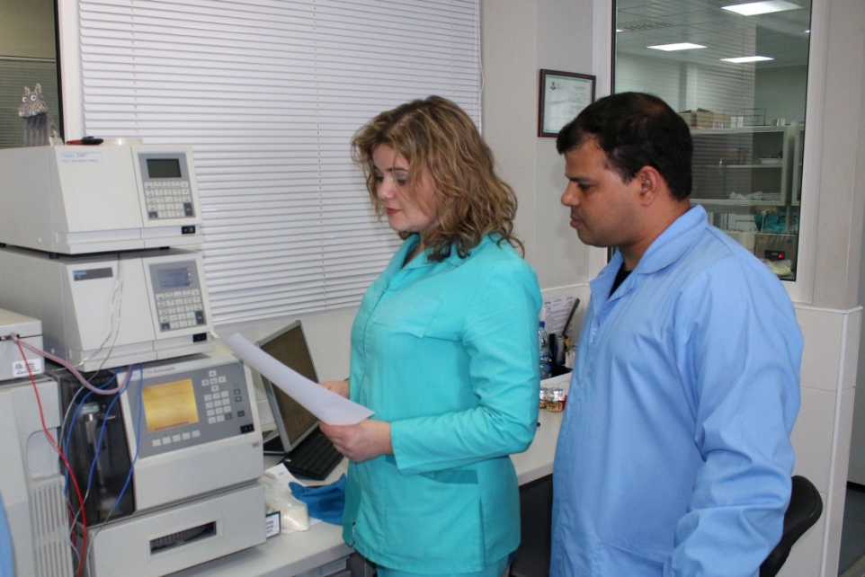
All stages checking of quality and effectiveness of dietary supplements.
Quality checking:
-At the initial stages, the company's laboratories conduct chemical, physical, biological, microbiological, toxicological and other studies. These product reviews help improve their quality, establish expiration dates and storage conditions, and make various recommendations for consumers.
Testing of the Final product in an Fssai accredited NABL laboratory .
Each new batch of products during the production process is additionally tested Basic tests and Quality control at Artlife laboratory.
We value our reputation, We provide consumers with the most complete and detailed product information so that they can reasonably trust the company's products.
consumers.

Slide 27
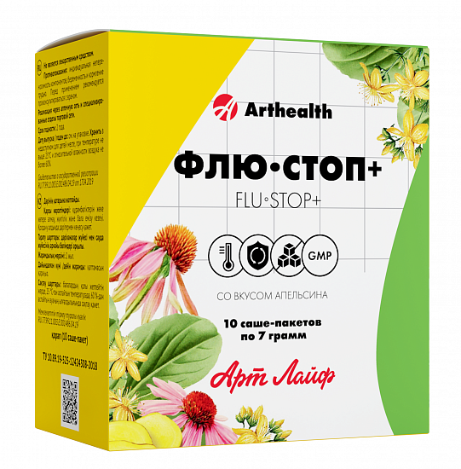
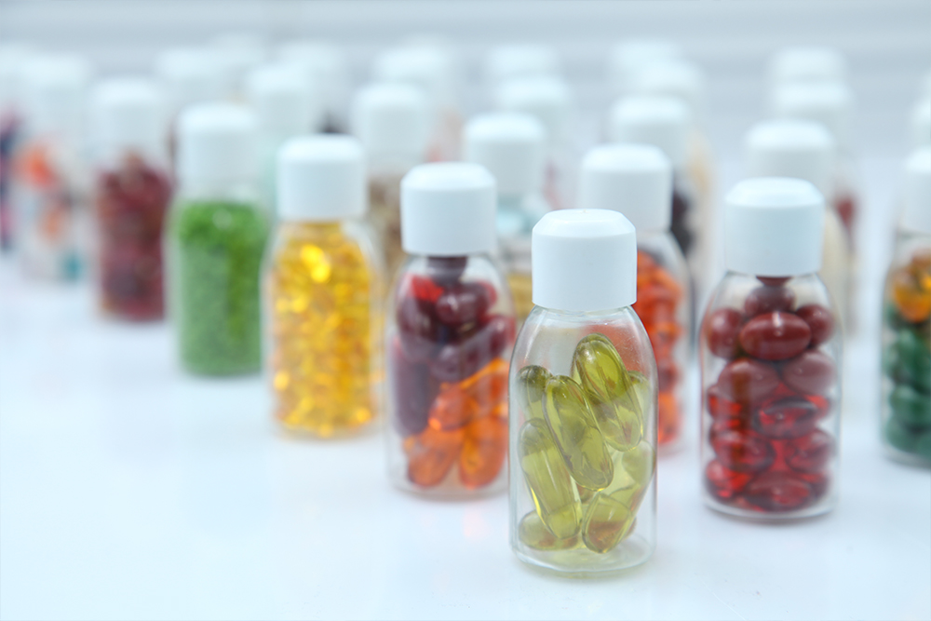
Soon
We are Launching something New.
-In Pouch packing /stick packing daily used Products for Immunity.
- Soft Gelatin capsule for Personal Wellness .

