Slide 2
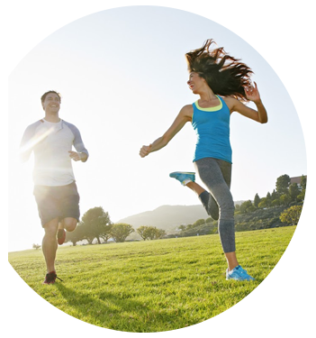
Feel the joy of movement!
Life is movement!
But sometimes the movement can be accompanied by unpleasant feelings, stiffness and crunch in joints.
It is nothing else than inflammation…

Slide 3
The inflammation of joints is the body’s natural response and reaction to the traumatic effect
The main causes of inflammation:
The trauma sustained after injuries, falling down, punches.
Тhe effect of allergens on the body.
The autoimmune diseases, in which antibodies destroy the components of joints.
The infectious diseases, which you came through.
Genetic predisposition
Excessive physical activity.
Overweight.
Malnutrition.
Natural age-related changes.

Slide 4
If you don’t take action, the acute process becomes chronic, so it is important to remove inflammation in joints immediately!

Slide 5
The inflammation of joints is the natural response and reaction of the body to the traumatic effect.
Symptoms of inflammatory processes in joints:
Pain in joints.
Swelling and edema in joints.
Redness and increases in temperature of joints.
Stiffness and functional disorders of the joints.

Slide 6
NATURASEPT JOINT FLEX GEL – IS AN EFFECTIVE PREPARATION, IT REMOVES INFLAMMATION, THAT CAUSED BY JOINT DISEASES AND INJURIES, AND IMPROVES THE MOBILITY.

Slide 7
Naturasept Joint Flex Gel helps:
Reduce and remove the inflammation process.
Decrease soreness in the affected and injured joints.
Reduce swelling and edema of joints.
Activate blood circulation in joints.
Improve the mobility and functions of the affected and injured joints.

Slide 8
It contains components, which have been used from the ancient times in the traditional Indian medicine (Ayurveda) in case of joint diseases.
The Directional impact
The active substances of these plants relieve pain syndromes, inhibit the action of aggressive agents, that destroy the joint tissues, stimulate the protective mechanisms in the joints and prevent the transition from acute to chronic inflammation.

Slide 9
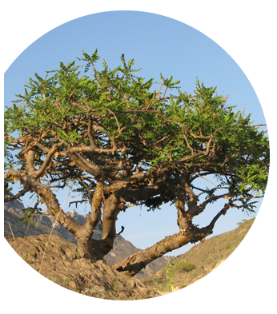
Boswellia extract
Composition
and effects:
Blocks inflammation in the joints.
Reduces the degree of joint cartilage damage.
Decreases the pain sense and morning stiffness in joints.
Reduces edema in joints.

Slide 10
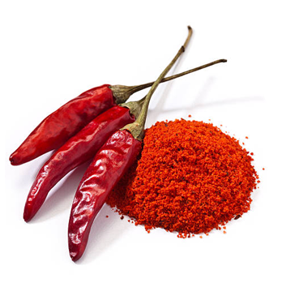
Capsaicin cayenne pepper
Composition
and effects:
Has a strong heating effect.
Reduces edema and severe pain in joints.
Reduces inflammation process.

Slide 11
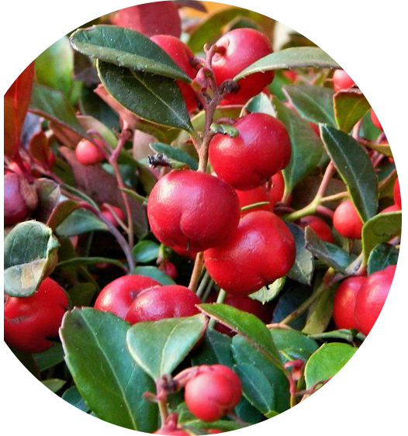
Gaulteria Essential Oil
Composition
and effects:
Performs vasorelaxant effect.
Reduces inflammation and pain in joints and tissues around the joints.
Eliminates bruises and edema.

Slide 12
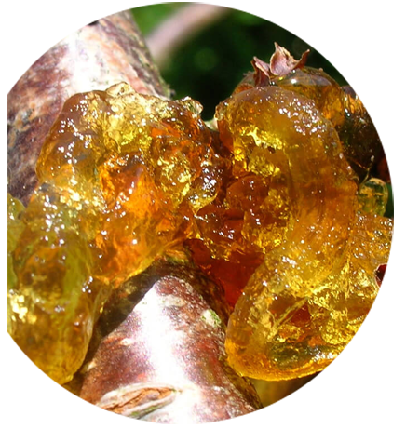
Boswellia Resin Oil
Composition
and effects:
Performs vasorelaxant effect.
Reduces inflammation. and pain in joints and tissues around the joints.
Eliminates bruises and edema.

Slide 13
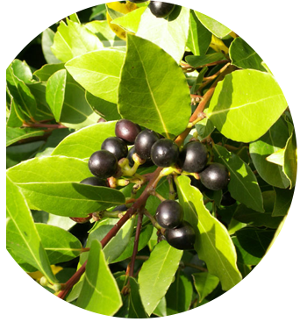
Camphor Tree Oil
Composition
and effects:
Improves blood flow.
Normalizes the tissue nutrition.

Slide 14
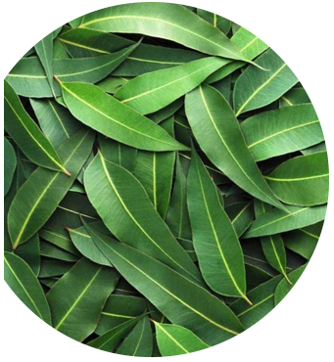
Eucalyptus Oil
Composition
and effects:
Promotes healing of micro trauma.
Performs anti inflammatory effect.

Slide 15
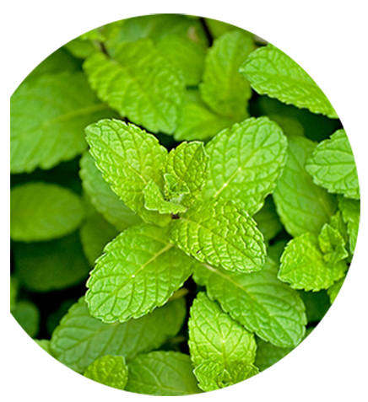
Peppermint Oil
Composition
and effects:
Promotes healing of micro trauma.
Performs anti inflammatory effect.

Slide 16
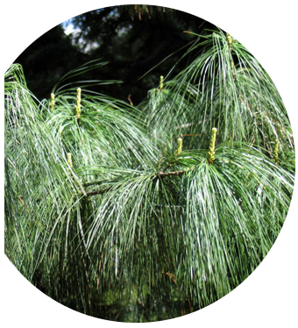
Indian Pine Oil
Composition
and effects:
Has anti rheumatic properties
Performs a relaxing effect

Slide 17
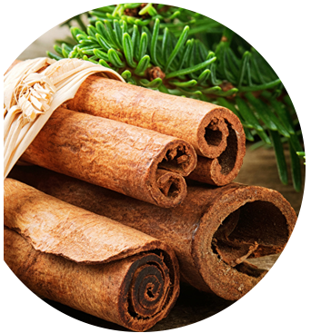
Cinnamon Oil
Composition
and effects:
Has a healing effect.
Reduces pain in joints and muscles.

Slide 18
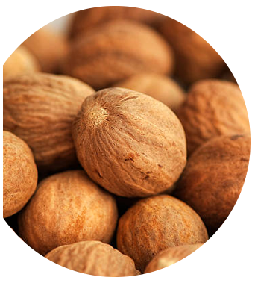
Nutmeg Essential Oil
Composition
and effects:
Has a heating effect
Relieves edema

Slide 19
Method of use:
Apply cream to preliminarily cleaned skin surface and evenly distribute it with light massaging movements 3-4 times per day. Cream wholly absorbs within 1-2 minutes and has its effect for 4-6 hours. The course of application should be 1-2 weeks or till relief. Repeat the course if necessary.

Slide 20
Program for musculoskeletal system diseases:
TOXFIGHTER ACTIVE | 3-4 Capsule 4 times a day with meal or as suggested by the Healthcare Professional.
NOVOMEGIN | 1 Capsule 1 time a day with meal or as suggested by the Healthcare Professional.
JFLEX FORTE | 1 Capsule 3 times a day with meal or as suggested by the Healthcare Professional.
CALCI-M | 1 Capsule 2 times a day with meal or as suggested by the Healthcare Professional.
In addition to above: Artlife functional foods, beverage Nutraceutical (Neocollagen powder), Naturasept Joint Flex Gel, professional consultation.

Slide 21
The simple rules for joint health
Take our recommendations and your joints will be always healthy

Slide 22
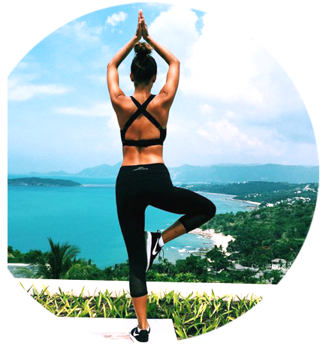
Maintain a healthy normal weight
…
The healthy weight helps to correctly redistribute the load on the all joints. But, extra weight is an additional burden on the joints, that can lead to damages and destruction of them.

Slide 23
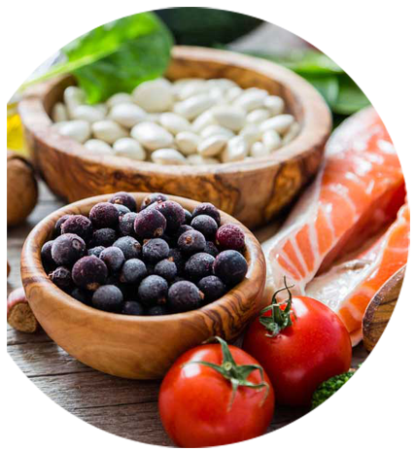
Eat healthy
…
The health of the joints depends on how healthy you eat. The intake of vitamins, micro- and macro elements into the body is an indispensable condition. We mean vegetables, fruits, nuts and grains. Especially pay attention to calcium and vitamin D.

Slide 24
Take care of your posture
…
Regardless of what kind of work you are doing, physical work or mental, don’t stay in one pose for a long time. Periodically, in order to relieve joints overload, do a 3-5 minute warm-up.

Slide 25
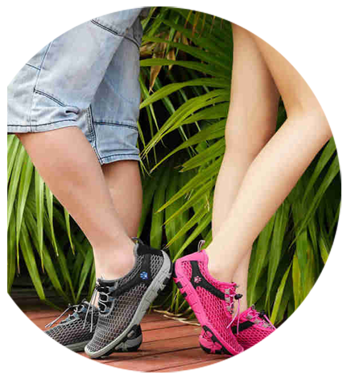
Wear comfortable shoes
…
Even the healthy joints require carefully selected shoes. Avoid models compressing the leg, with a high and unstable heel or with a hard sole. The most optimal for joints are the shoes with the heel of no longer than 3-6 cm.

Slide 26
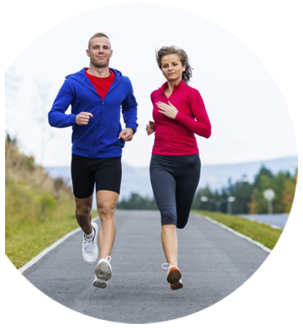
Go in for sports
…
Physical activity has a positive effect on the strengthening of all muscle groups and improves joints and ligaments condition.

Slide 27
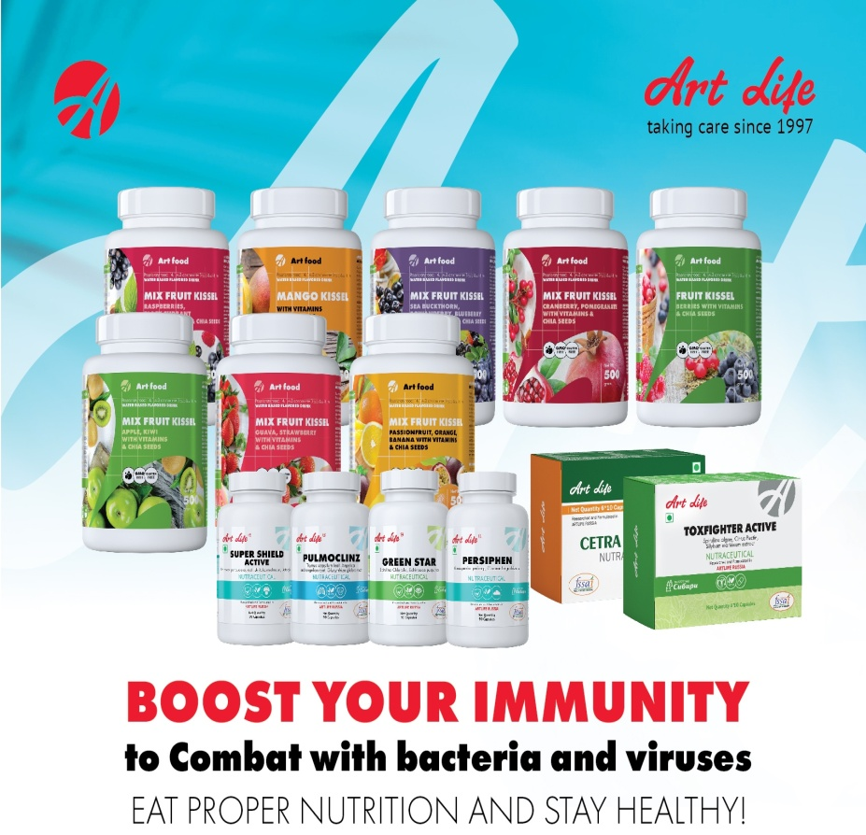
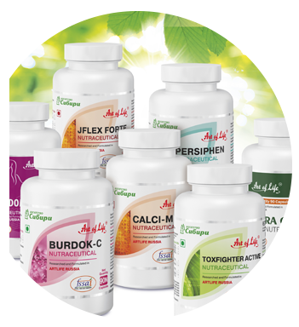
Intake the biologically active complexes
…
Biologically active complexes help maintain healthy joints. To reach this goal, Artlife’s biologically active complexes are perfectly suitable.

Slide 28
Thank you
Note:-These products are not intended to diagnose, treat, cure or prevent any disease.
NOT FOR MEDICINAL USE

