Slide 2
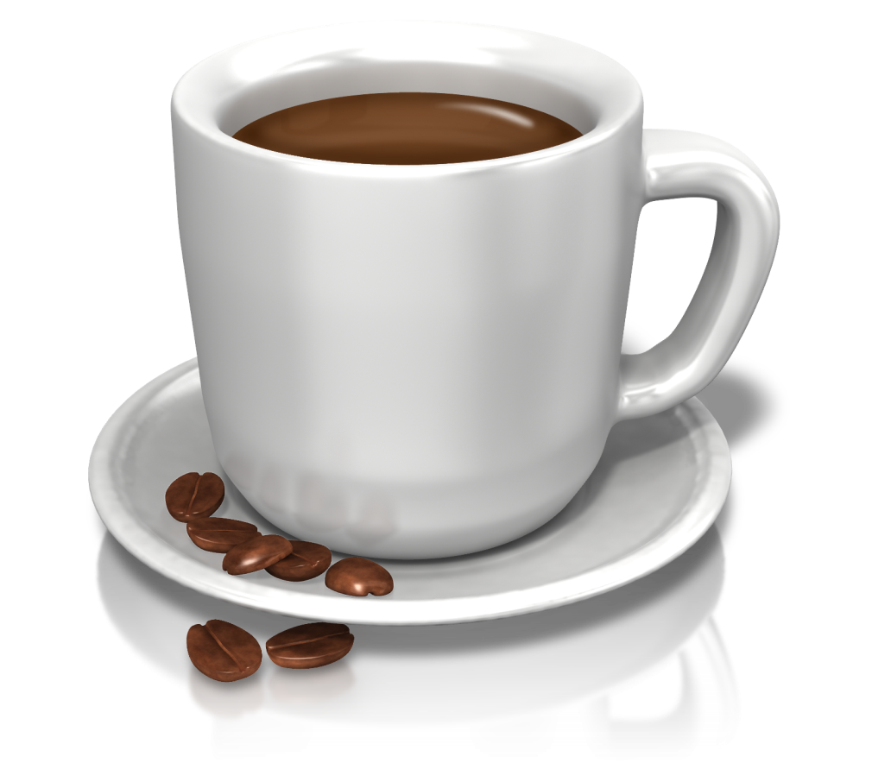
Functional beverages for health and good mood!
Made with high quality ingredients
Enriched with vitamins and plant extracts
Have full taste and rich flavor

Slide 3
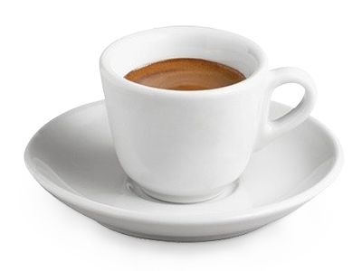
Coffee memory plus
Delicate flavor of milky coffee with a tender tinge of cherry!
Coffee for good memory!
On fructose
Coffee memory plus not only gives you a great mood and energy boost, but also increases your mental capacity! Gingko Biloba and Gotu Kola natural extracts are useful for good memory conservation and make this beverage unique. The active components promote high working capacity and good mental performance all day long.
Gotu Kola in ancient times is called as “fountain of youth”. Ancient people believed that it has a capacity to sustain human life. This plant improves cerebral circulation and brain oxygen supply, and thereby, speeds up thinking process, improves memory capacity and helps you get rid of a headache.
Gingko Biloba strengthens vessel walls, promotes the proper cerebral circulation.
Vitamins complex helps to reduce fatigability and restore life energy.

Slide 4
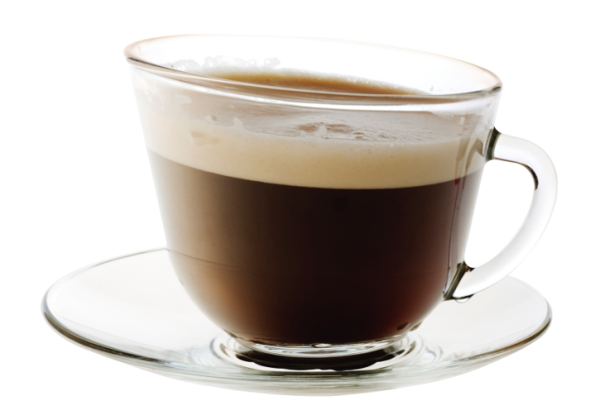
Coffee Energy
Rich intriguing flavor of classic coffee with a tinge of milky caramel
Coffee for energy!
On fructose
Coffee Energy boosts your mood and makes you emotionally charged for the whole morning. Rich flavor of classic coffee is completed with a tender tinge of milky caramel. Ginseng and green tea natural extracts help to restore life energy and feel better.
Ginseng is a fabulous plant, it is known for more than four thousand years. Ginseng is used as a restorative and general tonic, in order to increasing the level of the mental and physical working capacity, resistance of organism against stresses and adverse effects of the external environment.
Green Tea boosts your immune system performance and protects cells from breakage. Vitamins complex helps to reduce fatigability and restore life energy.

Slide 5
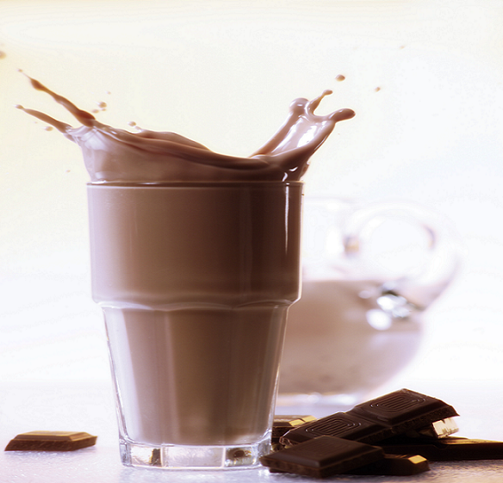
Drinking Chocolate Powder
Natural beverage, useful for all of the family
Hot Chocolate contains a unique complex of vitamins and L-Carnitine, which are supplementing the usefulness of the hot chocolate, providing energy, maintaining the health and good mood.
L-Carnitine helps to increase endurance capacity and reduce fatigability of the organism. Helps to recover muscles after hard physical workout and protects muscle damages during the exercises.
Vitamin C provides normal function of immune and hematopoietic systems.
Vitamin E slows down aging process, supports immune health, has anticarcinogenic effects, and is necessary for the normal function of the heart muscles
B-complex vitamins take part in the energy metabolism and increase workability.
One cup of the hot chocolate in the morning provides energy boost all day long!

