Slide 2
The main defects of nutrition of population
The Excess of :- Animal fats,
simple carbohydrates, salt, animal protein, alcohol, toxins, medicines, carcinogens, pesticides and hormones
Balanced nutrition
The deficiency of:
Unsaturated fats, fibers, vegetable proteins, vitamins, microelements and probiotics.

Slide 3
Polyunsaturated fat deficiency symptoms
Polyunsaturated fat and vitamin deficiency in the daily ration
Inhibition of growth and development
High prevalence of atopic diseases
Deterioration of vision
Psycho emotional instability
Increased fatigue
Recidivist current of chronic diseases

Slide 4
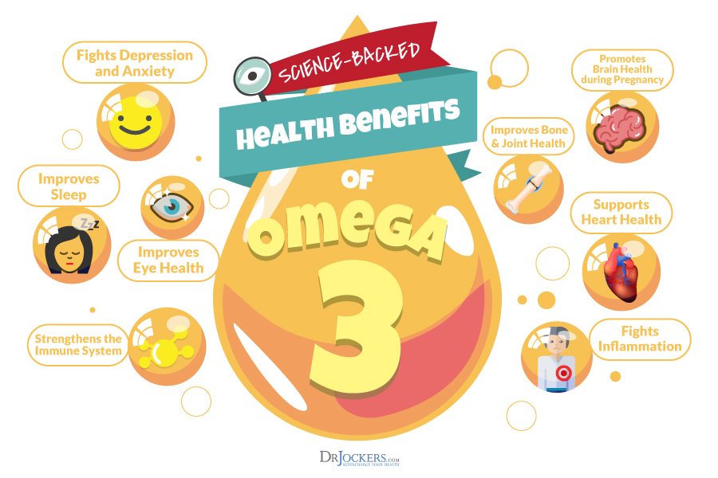
What kinds of fats are there?
Classification of fatty acids, OMEGA-3, OMEGA-6, OMEGA-9 are based on provision of some kind of Carbon Double Bond inside the molecules
ПНЖК не синтезируется организмом и должны поступать в него с пищей.
Самые важные ПНЖК:
Альфа-линолевая
Докогексаеновая
эйкозапантеновая
GOOD FATS vs BAD FATS
«GOOD» fats are known as unsaturated fatty acids:
Unsaturated fats:
Omega-3 and Omega-6
Monounsaturated fats: Omega-9
They represent dietary fats, which help to maintain healthy growth and functioning of body.
The body cannot synthesize them by itself, but the presence of these fats in daily ration is very important!
«BAD» FATS include:
Saturated fats: milk fat (butter, cream), lard and visible fat on meat
Trans fats: partially hydrogenated vegetable oils
Bad fats contribute to the development of cardiovascular diseases system, excess weight gain and metabolic disorders.
It is very important to limit their consumption.

Slide 5
The balance of omega-3 and omega-6
The recommended ratio of omega-3 and omega-6 in the daily ration is from 1:2 to 1:4
The omega-6, that most of people receive from daily ration is 15-25 times more than the quantity of received omega-3.
Omega-3
Omega-3
Omega-6
The best sources of polyunsaturated fat omega-3 (EPA and DHA) are wild fishes and some kinds of seaweeds.
The problem :
Many children and adults are not eating fish or seaweeds on a regular basis, so they face a high risk of having a low omega-3 level and an excess omega-6 consumption.

Slide 6
Statistics: «Northern paradox»
By the 80th years of the twentieth century, the "northern paradox" was already known: the people of Greenland, Aleuts, Eskimos and other residents of northern lands almost have no atherosclerosis!

Slide 7
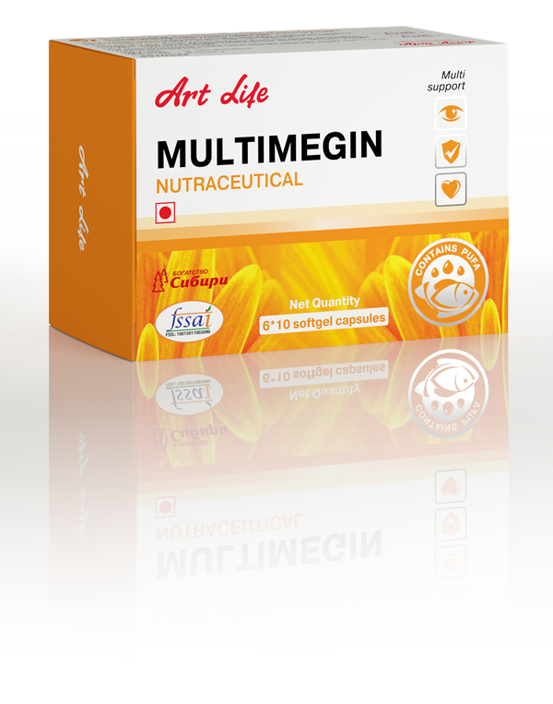
MULTIMEGIN
Emotional status support
Improvement of brain functioning
Joint diseases prophylaxis
Eye health care
Improvement of skin conditions
Strengthening of vessels
Reduce inflammatory processes
Immunity system support
An integrated supplement for health care
NOT FOR MEDICAL USE

Slide 8
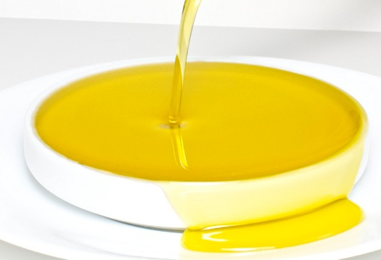
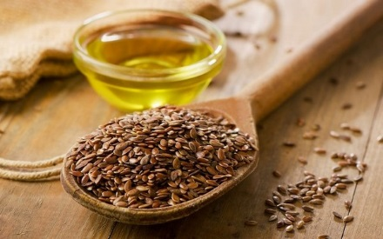
Ingredients of integrated supplement
MULTIMEGIN
Fish fat
Flaxseed oil
Lutein and Zeaxanthin
Vitamins
NOT FOR MEDICAL USE

Slide 9
A combination of animal and vegetable sources of OMEGA-3
MULTIMEGIN
Fish fat
Flaxseed oil
Polyunsaturated fat content in daily dose (2 capsules):
Fish fat: not less than 420 mg (Total content of EPA and DHA- 146 mg)
Flaxseed oil: not less than 200 МГ (alpha-Linolenic acid– 88 mg)

Slide 10
MULTIMEGIN
Fish fat contains the most essential polyunsaturated fatty acids omega-3: Eicosapentaenoic acid and Docosahexaenoic acid.
Eicosapentaenoic acid (EPA) | Docosahexaenoic acid (DHA)
Has anti-inflammatory effect Anti-atherosclerotic action (reduces cholesterol and triglyceride levels in the blood) Antiaggregatory action Immunomodulatory effects Important for proper development and maintenance of retinal function. | Reduces triglyceride levels, обладает мягким гипотензивным действием Important for the formation of the brain and vision in children and beneficial for the cerebral circulation Prevents body fat accumulation Has anti-inflammatory effect Maintains central nervous system, supports emotional status, has a positive effect on memory and concentration
Being a rich source of EPA and DHA,
«MULTIMEGIN» Supports all body functions!
NOT FOR MEDICAL USE

Slide 11
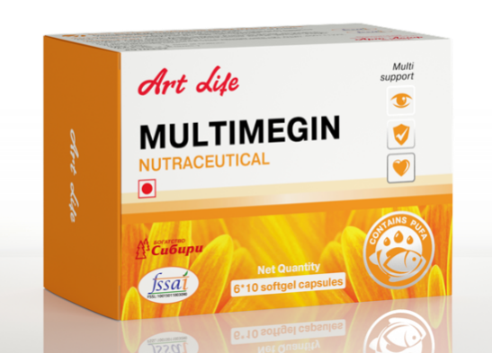
MULTIMEGIN
ATTENTION!
EPA and DHA, which are used in the composition of “MULTIMEGIN” complex, produced from muscle tissues of high grade fishes. Exactly this fish fat contains the most omega-3 fatty acids content and at the same time, doesn’t contain toxic substances.
In the production process, the fat passes through several purification stages and more than 200 times has tested and checked.

Slide 12
MULTIMEGIN
Flaxseed oil, used in “MultiMegin” supplement contains an important alpha linolenic acid
Alpha linolenic acid (ALA)
Proper development of brain, organs of vision, sex glands Nerve impulse transmission; fighting against stress brain activity Elaboration of prostaglandin E Adjustment of arterial pressure and blood cholesterol level, purification of blood vessels Preserving moisture in the skin and hair
NOT FOR MEDICAL USE

Slide 13
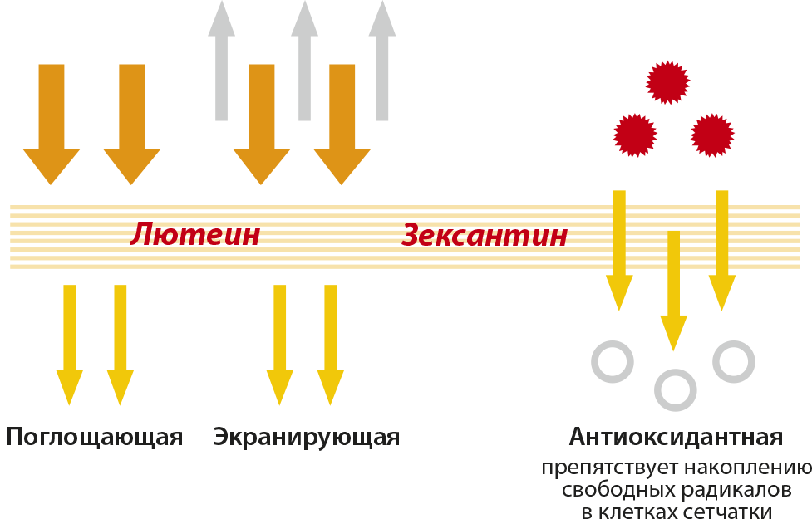
Lutein and Zeaxanthin– nutrients for vision health care
Zeaxanthin and lutein (source- natural extract of calendula) – The natural pigments belonging to the group of carotenoids. They perform a strong antioxidant action and prevent retina to be damaged by UV radiations (inhibit up to 60% of harmful radiations, which can destroy retina).
The higher density of lutein in retina, the lower risk of damage. Due to the lack of lutein in food, protective functions of retina are reduced, and it can lead to the dystrophy of the pigment layer of the retina and reduced vision.
lutein
Zeaxanthin
Absorbing
shielding
Antioxidant
Mechanism of protective reactions of lutein and zeaxanthin
NOT FOR MEDICAL USE

Slide 14
MULTIMEGIN
Vitamins, included in the composition of MultiMegin supplement, compensate the deficiency and guarantee the reserve of the most important nutrients.
Name | Effect
Fat-soluble vitamins– Alpha-tocopherol, beta-carotene -carotene, cholecalciferol | Have antioxidant actions, take part in construction of skeleton, due to the activation of calcium and phosphorus metabolism.
Vitamin А | Responsible for colors of vision, its sharpness, the eye adaptation rate. Increase the body resistance to the infections. Improve skin and hair conditions.
Vitamin Е | It is a very powerful antioxidant, that binds active oxygen molecules, which are formed during biochemical processes and damage healthy cells. Enhances the absorption of beta-carotene and polyunsaturated fatty acids. Supports the healthy development of sex and endocrine glands.
В group vitamins | Coenzymes in biochemical reactions, which take part in all processes of body. Strengthen the nervous system, are responsible for energy metabolism, support the health of the digestive system, help stabilize blood sugar levels, support the immune system.
L-ascorbic acid | Increases the body resistance to the infections and adaptive opportunities of body. Stimulates the growth, metabolism, activities of endocrine glands, blood circulation, and the formation of bone and tooth tissues.
.
NOT FOR MEDICAL USE

Slide 15
IS RECOMMENDED FOR
MULTIMEGIN
Children from 3 years old
Teens
Adults
«MULTIMEGIN» IS AN INTEGRATED SUPPLEMENT, THAT CAN BE A PART OF A BALANCED DIET AND IT HAS VALUABLE ADVANTAGES FOR HEALTH CARE AT ALL STAGES OF LIFE–
FROM THE EARLY AGE UP TO RIPE AGE.
NOT FOR MEDICAL USE

Slide 16
MULTIMEGIN
Advantages for children (3-14 years old)
Provides support for all processes of growth and development, especially during the period of formation of bones and teeth Maintain the proper functioning of nervous system, heart and organs of vision Increases the concentration and focusing, improves learning ability. Prevents reduced vision due to overloads Helps to strengthen the immunity system, prophylaxis of respiratory diseases You can use it in order to prophylaxis of allergies, asthma, and skin diseases
Recommendation for use, dosage: For children (3-7 years old) 1 capsule 1 time a day during the meal. For children and teens (7-14 years old, 14 – 18 years old) 1 capsule two times a day during the meal.
Children from
3 years old
NOT FOR MEDICAL USE

Slide 17
MULTIMEGIN
Advantages for teens
Support for healthy development of brain and nervous system and also reproductive system. Support for a normal metabolism, prevents excess weight gain. Improves the skin conditions, helps fight against acne Prevents reduced vision due to overloads. Contributes to prophylaxis of allergies, asthma, and skin diseases Increases concentration and focusing, normalizes emotional status, increase resistance to the increased psycho emotional overloads and stresses.
Recommendation for use, dosage: For teens (14-18 years old) 1 capsule 2 times a day during the meal.
TEENS
NOT FOR MEDICAL USE

Slide 18
MULTIMEGIN
Advantages for adults
Has a positive effect on the inflammatory processes (in cases of arthritis and other chronic diseases) Preserves the elasticity of cell’s membranes (in blood vessels, eyes and nerves), prevents arterial sclerosis inhibits degenerative vision loss Maintains brain functions Reduces the risk of depression Contributes to the prophylaxis of allergies, asthma, and skin diseases Prevents premature aging
Recommendation for use, dosage: For adults, 1 capsule 2 times a day during the meal.
ADULTS
NOT FOR MEDICAL USE

Slide 19
Thank you for attention!
Recommended usage:
1 capsule 1 time a day with meal or as suggested by the healthcare professional.
Note:-These products are not intended to diagnose, treat, cure or prevent any disease.
NOT FOR MEDICINAL USE

