Slide 1
Health begins from a little
step
95% of people
WANT to be treated,
5% — take real ACTIONS
To support their health
WOULD YOU LIKE TO KNOW TO WHAT CATEGORY YOU BELONG?

Slide 2
!
HEALTH ?
The state of total physical, spiritual and social well-being, and not only the absence of illnesses and physical defects

Slide 3
?
OUR HEALTH
DEPENDS ON
Human body consists of twelve systems, that are divided by principle of performed functions: cardiovascular, digestive, respiratory, reproductive etc. Systems consist of organs, organs consist of tissues, tissues consist of cells.

Slide 4
ORGANS
PERSON
12 SYSTEMS OF ORGANS
TISSUES
CELLS
!
THE MAIN BASE —
IS THE HEALTH
OF A CELL

Slide 5
WHEN SHOULD PEOPLE TAKE CARE OF THEIR HEALTH?
WHEN THE FIRST SYMPTOMS OF ILLNESS APPEAR
!
REGULARLY!

Slide 6
WHAT ARE THE NECESSARY ACTIONS TO KEEP AND ENRICH BODY’S HEALTH?
?
REMOVE THE WASTE – GIVE THE ESSENTIAL!

Slide 7
MODERN PEOPLE
ARE UNDER NUMEROUS ATTACKS
OF NEGATIVE FACTORS:
• Hazardous environment.
• Stress.
• Physical inactivity.
• Hypoxia.
• Unhealthy diet.
EVERY YEAR
WE LOSE…
…SOMETHING,
WE CAN KEEP,
IF WE KNOW HOW!

Slide 8
TRANSFATS
REMOVE
THE WASTE!
They are produced from plant oils by special processing method — hydrogenation: hydrogen runs through liquid oil that is heated to very high temperatures. As a result they get solid, fat mass that is stable to oxidation.

Slide 9
TRANSFATS
REMOVE
THE WASTE!
It is delivered to the child with breast milk.
The risk of diabetes development increases.
The state of joints and conjunctive tissues worsens.
Immune system is weakened.
The level of male hormone testosterone is lowered and sperm quality becomes bad.
Negative consequences of consuming transfats
Consuming only 2% more transfats (only 4 grams a day!) increases the risk of ischemia heart disease by 23%

Slide 10
DYSBIOSIS
REMOVE
THE WASTE!
AMMONIA, AMINES, PHENOL, INDOL, SKATOLE.
These substances are transferred to blood, and affects the liver significantly
C₆H₅OH

Slide 11
DYSBIOSIS
REMOVE
THE WASTE!
Infections diseases.
Antibiotic intake.
Chemical, hormones and radiation treatment.
Stress situations.
Large physical exertions and defatigation.
Hazardous environment.
Overeating.
Alcoholism.
Seasonal factors (autumn and spring).
Age.
REASONS

Slide 12
АB
540 AGGRESSIVE BACTERIA
There are 1420 types of Causes for human diseases
!
V
210
VIRUSES
P
70 PROTOZOAN
F
313
FUNGI
G
287
GERMS

Slide 13
MAIN ENEMIES OF THE CELL
АBVF PG
АB
AGGRESSIVE BACTERIA
Health workers discovered about 70 types of tapeworms, that infects people, more than 30 of them are massively distributed, but only 11 tapeworms can be officially registered.
V
VIRUSES
P
PROTOZOAN
F
FUNGI
G
GERMS

Slide 14
FREQUENCY OF PARASITIC DISEASES
АB
AGGRESSIVE BACTERIA
Every year more than 20 million people are suffering and there is tendency to increase.
As WHO (World Health Organization) has evaluated – out of all most prominent infections and parasitic diseases sick people with tapeworms are on 3rd place in the world (1,4 billion), and jungle fever on fourth (600 million)!
To compare, every year the number of people suffering from influenza and other acute respiratory diseases is the 6th no. the world (395 million).
V
VIRUSES
P
PROTOZOA
F
FUNGUS
G
GERMS

Slide 15
CLEANSING WASTE AND TOXINS
To remove toxic influence and to clean up our cell – this is the base for our health!
?
DISPOSAL OF GERMS
NORMALIZING MICROBIAL POPULATION
MAKE IMMUNE SYSTEM STRONGER
RECOVERING OF METABOLISM

Slide 16
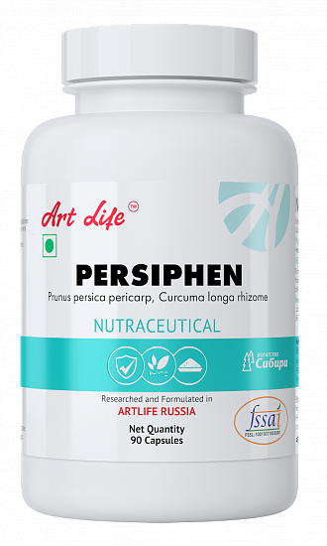
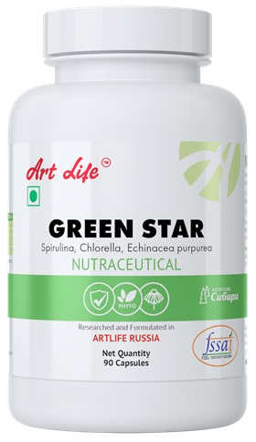
Artlife products will help you to Correct Immune system, normalize acid-base balance, to clean up the body and to prevent parasitic disease
EVERY PERSON NEEDS A
COMPLEX BODY CLEAN-UP
2 TIMES IN A YEAR
!

Slide 17
SATISFYING CELL’S THIRST
!
Water is the most important – it is perfect solvent, it brings health or illness.
A man should drink more than 2.5 liters of pure water every day.

Slide 18
HARMFUL
USEFUL
Clear water (bottled, boiled, without microelements, with chloride
From the water pipe-line), untreated (hard water with high concentrations of harmful compounds), and also artificial drinks with colorants and preservatives agents
«Harmful» drinks lead to the loss of
microelements
And to osmotic destruction (bursting) of the cells.
Drinks, that contain
Necessary microelements,
vitamins.
«Useful» drinks
Normalize the electrolytic balance and provide optimal function to the cells
!
GIVE YOUR
CELL
WATER OF LIFE

Slide 19
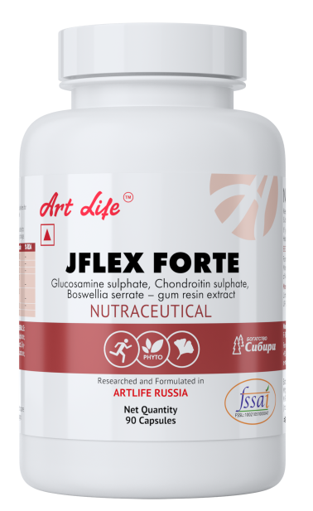
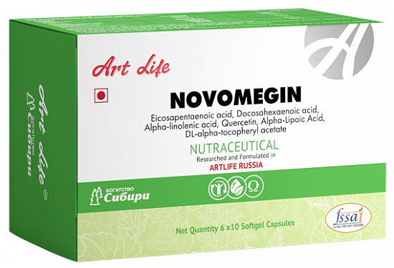
YOU CONSUME FOOD EVERY DAY, BUT DOES YOUR CELL RECEIVES
WHAT IT NEEDS?
?

Slide 20
3
Polyunsaturated fatty acids
17 ENZYMES
12
VITAMINS
15
MINERALS
TAKE ARTLIFE
BIOCOMPLEXES
AND PROVIDE
NUTRIENT ENRICHED
FOOD FOR YOUR CELLS
!
20 AMINOACIDS

Slide 21
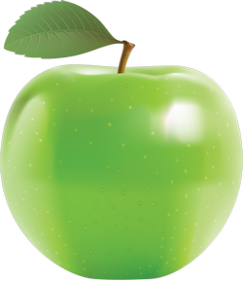
WHY IN OUR DAILY FOOD INTAKE
BIOLOGICALLY ACTIVE COMPLEXES OR SUPPLEMENTS ARE NECESSARY
?
During last 100 years
Content has lowered in the apples
Fe – by 96%,
Ca – by 48%,
Mg - by 83%,
K content has lowered in cabbage by 58%,
In tomatoes — Ca by 61%
Consuming of «useful» bacteria along with the food has lowered 100 times in the last 100 years.

Slide 22
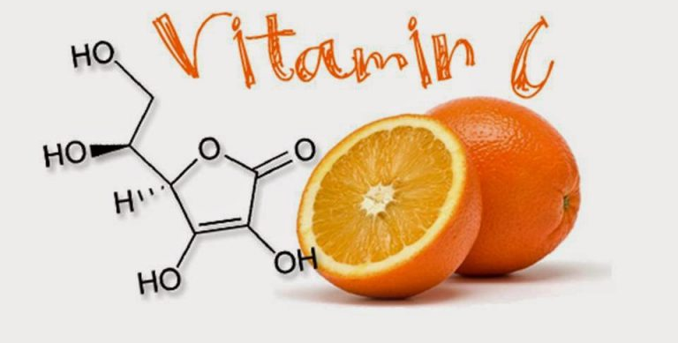
VITAMIN С
!
Not many people know, that during 2 hours of the stress situation the whole amount of vitamin С in the body is utilized.
And the body needs to supplement it!
Activates 300 different functions

Slide 23
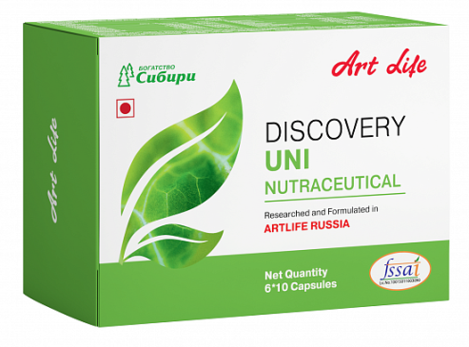
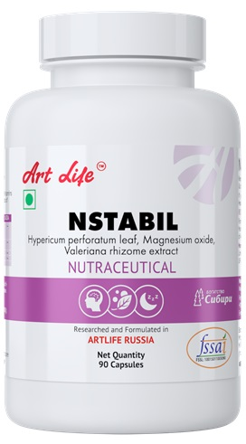
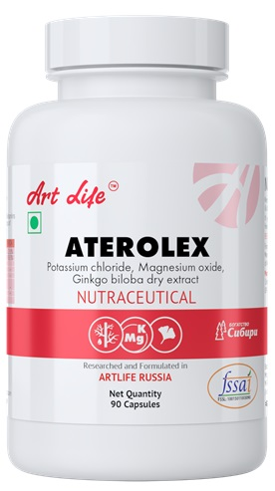
What is necessary to keep health?
KNOWLEDGE
INSTRUMENTS
!
FOR THE PEOPLE WHO WANTS TO BE HEALTHY AND DON’T WANT TO GET FUTURE HEALTH PROBLEMS
THERE ARE POSSIBILITIES AND RESOURCES WITH ARTLIFE!

Slide 24
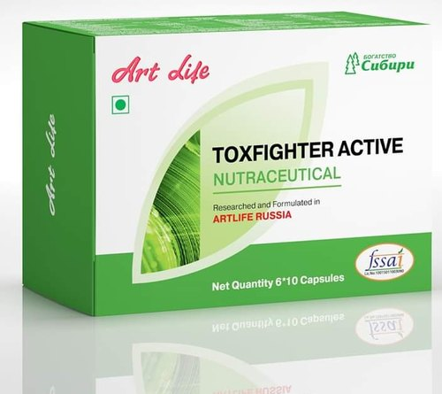
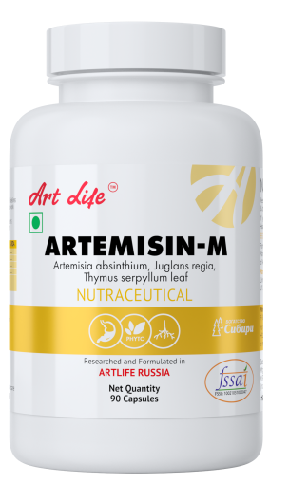
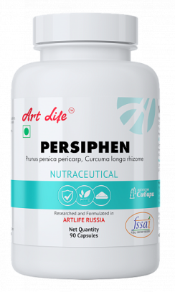
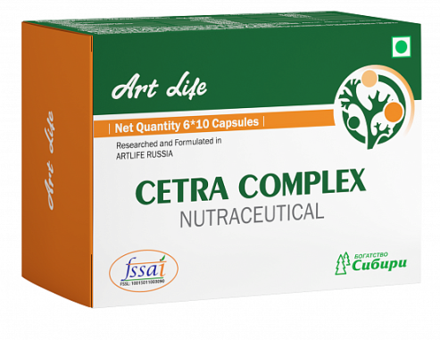
Intestinal cleansing,
Immune system strengthening,
Nervous system strengthening
1 step of cleansing program
!
1 step of cleansing program:
TOXFIGHTER ACTIVE
NSTABIL
GTRIGEL
ARTEMIZIN-M
PERSHIPHEN
CETRA COMPLEX
Weight lowering
Cleansing courses should be run not less than 1-2 times a year

Slide 25
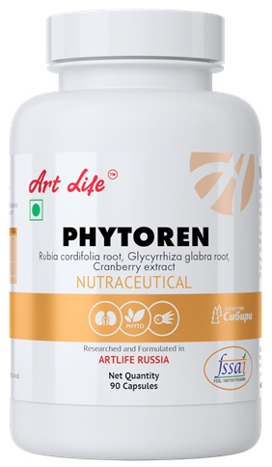
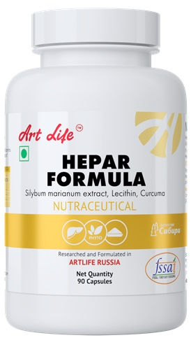
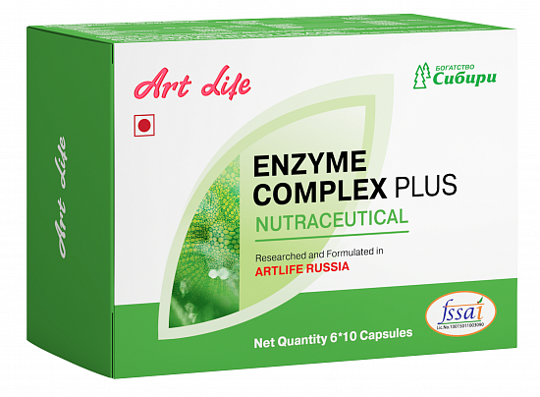
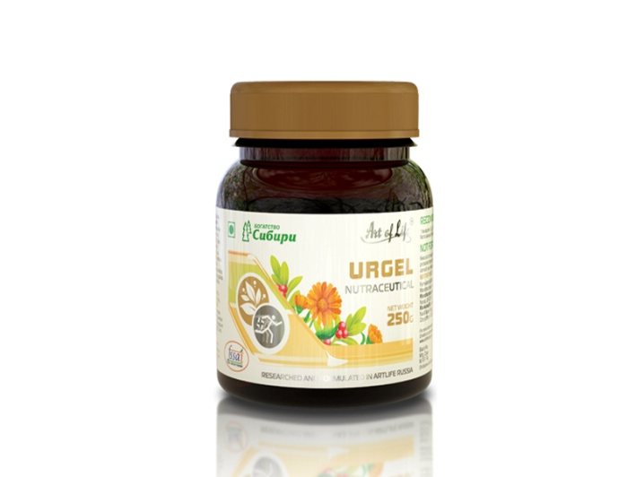
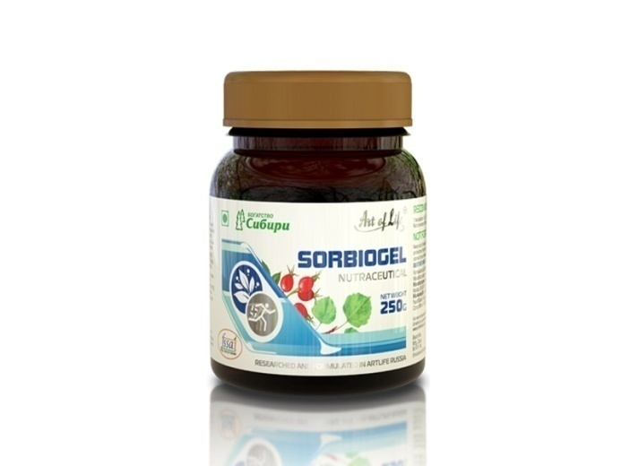
2 step of cleansing program
Liver and kidneys
cleansing
!
2 step of cleansing program:
ENZYME COMPLEX PLUS
PHYTOREN
HEPAR FORMULA
UROGEL
SORBIOGEL
Weight lowering
Cleansing courses should be run not less than 1-2 times a year

Slide 26
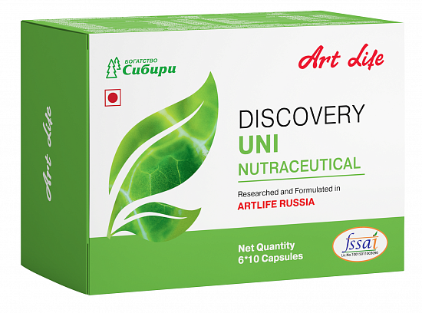
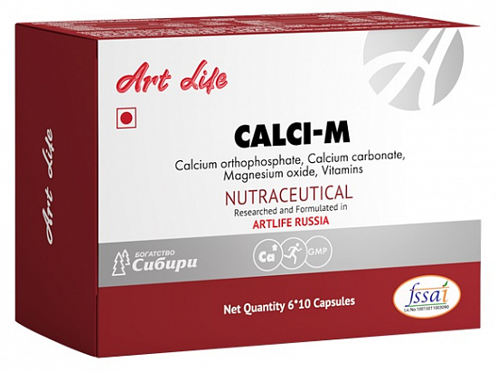
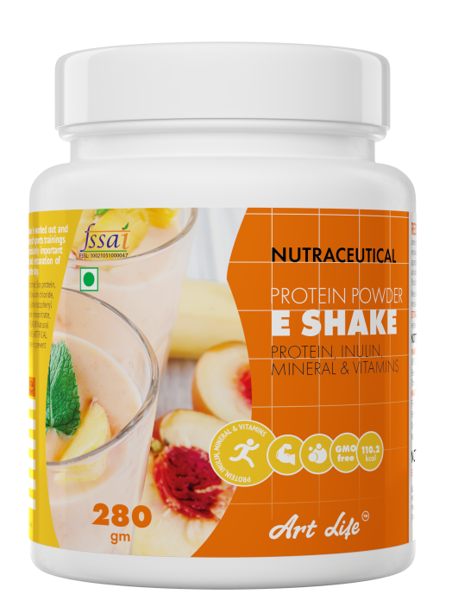
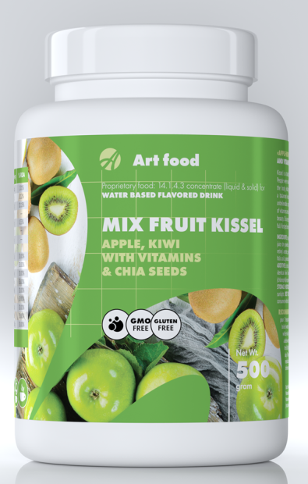
3 step of cleansing program
Recovery of microbial population
Supplementing of nutritional elements
!
3 step of cleansing program:
DISCOVERY UNI
CALCI-M
ANY KIND OF KISSEL
ANY KIND OF SHAKES

Slide 27
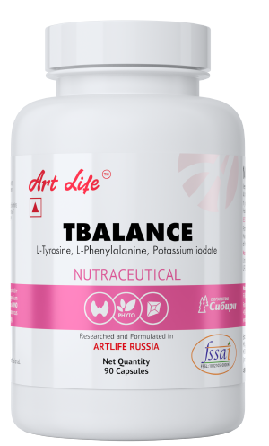
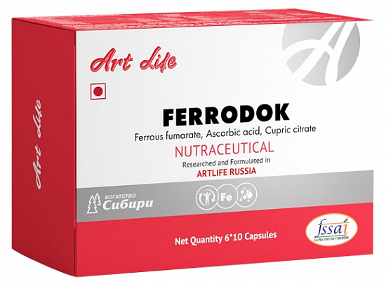
The Basic products
The basic program is designed to meet the daily needs of the body in vital biologically active substances.
!
The basic product:
NOVOMEGIN
CALCI-M
FERRODOK
TBALANCE
GREEN STAR

Slide 28
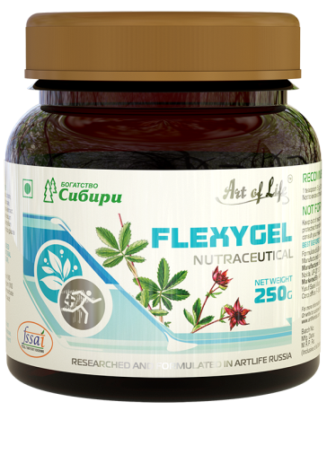
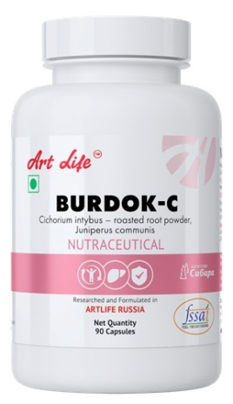
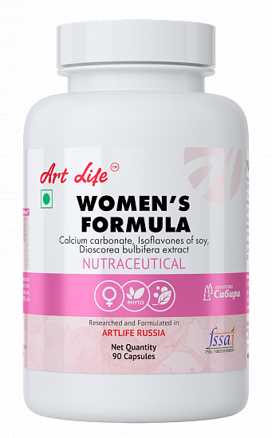
Products intended to support skeletal system
Products for support skeletal system helps ensure the health of bones, ligaments and joints.
!
The basic product:
CALCI-M
J-FLEX FORTE
NOVOMEGIN
FLEXYGEL
Additional products:
ENZYME COMPLEX PLUS
WOMEN’S FORMULA
BURDOK-C
NATURASEPT JOINT FLEX GEL

Slide 29
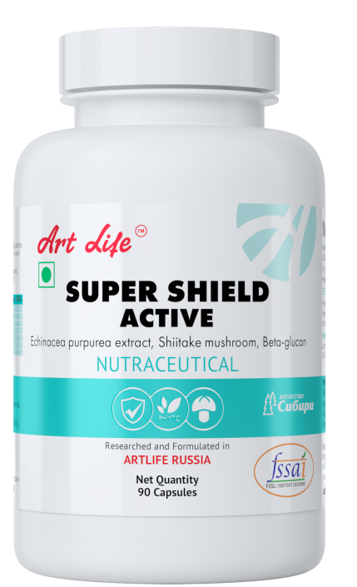
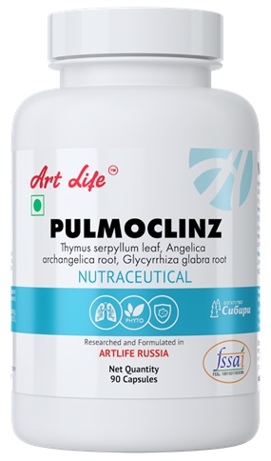
Products intended to support Immune system
Products for support immune system increases the body's resistance to virus and bacteria
!
The basic product:
CETRA COMPLEX
GREEN STAR
PULMOCLINZ
PERSIPHEN
SUPER SHIELD ACTIVE

Slide 30
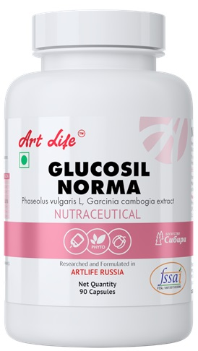
Products intended to support endocrine support
Products for support endocrine system helps to improve metabolism
!
The basic product:
PERSIPHEN
GLUCOSIL NORMA
TBALANCE
WOMEN’S FORMULA
GREEN STAR

Slide 31
Gain your health
With Artlife
And enjoy
the life
!
Note:-These products are not intended to diagnose, treat, cure or prevent any disease.
NOT FOR MEDICINAL USE

