Slide 1
AcCo svaasqya kI SauÉAat ek CaoTo kdma sao haotI hO
95‰ laaoga [laaja kranaa caahto hOM¸
5‰ — Apnao svaasqya kI rxaa ko ilae kdma ]zato hOM
@yaa Aap jaananaa caahoMgao ik Aap iksa EaoNaI maoM Aato hOMÆ

Slide 2
!
svaasqya ka Aqa- hO -
saMpUNa- SaarIirk¸ maanaisak AaOr saamaaijak svasqata¸ na ik kovala baImaarI yaa SaarIirk daoYaaoM ka na haonaa

Slide 3
?
hmaara svaasqya iksa pr inaBa-r krta hOÆ
maanava SarIr maoM baarh p`NaailayaaÐ haotI hOM¸ jaao ]nako Wara ike jaanao vaalao kayaao-M ko AaQaar pr vagaI-Ìt haotI hOMÁ.
)dya–naaDI tM~¸ pcana tM~¸ Svasana tM~¸ p`janana tM~ Aaid. p`NaailayaaÐ AMgaaoM sao banatI hOM¸ AMga }tkaoM sao banato hOM AaOr }tk kaoiSakaAaoM sao banao haoto hOM.

Slide 4
AMga
vyai>
AMgaaoM sao banaI 12 p`NaailayaÐ
}tk
kaoiSakaeÐ
!
mau#ya AaQaar hO —
kaoiSaka ka svaasqya

Slide 5
laaogaaoM kao Apnao svaasqya kI doKBaala kba krnaI caaiheÆ
baImaarI ko p`qama laxaNa idKnao pr
!
inayaimat $p saoÑ

Slide 6
SaarIirk svaasqya banaae rKnao AaOr ]sao baohtr banaanao ko ilae @yaa AavaSyak kaya- haoto hOMÆ
?
kcara inakalaoM — AavaSyak t%va laoMÑ

Slide 7
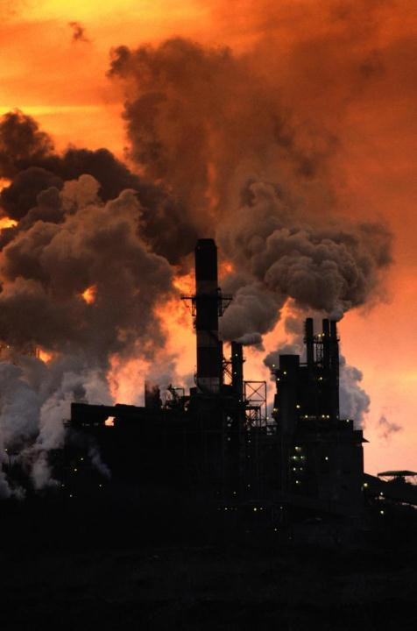
AaQauinak samaya maoM laaoga kš nakara%mak karkaoM sao ga`isat haoto hOMÁ • Ktrnaak vaatavarNa
• tnaava
• SaarIirk inaiYËyata
• vaatavarNa maoM Apyaa-Pt Aa^@saIjana
• AsaMtuilat Baaojana
hr saala¸ hma kuC eosaa Kao doto hOMººº
…jaao hma banaae rK sakto qao¸ yaid hmaoM pta haotaÑ

Slide 8
T/aMsafOT\sa
kcara inakalaoMÑ
yao vanaspit tolaaoM sao ek ivaSaoYa p`iËyaa – ha[D/aojanaoSana – Wara ]%pnna haoto hOMÁ ha[D/aojana kao A%yaMt gama- tola sao haokr gauja,ara jaata hO. pirNaamasva$p ek zaosa¸ vasaayau> pdaqa- imalata hO ijasa pr Aa^@saIkrNa ka p`Baava nahIM pDta.

Slide 9
T/aMsafOT\sa
kcara inakalaoMÑ
yah maaÐ ko dUQa Wara baccao kao imalata hO.
maQaumaoh haonao kI saMBaavanaa baZ jaatI hO.
jaaoDaoM AaOr AaMKaoM kI iJallaI ko }tkaoM kao nauksaana phuÐcata hO.
raoga–p`itkar xamata kmajaaor haotI hO.
puÉYaIya harmaaona TosTaosToraona ka str kma haota hO AaOr vaIya- kI gauNava<aa GaT jaatI hO.
kovala 2‰ ³maa~ 4 ga`ama p`itidnaÑ´ AiQak T/aMsafOT laonao sao r>alpta )dya raoga kI jaaoiKma 23‰ baZ jaatI hO
Baaojana maoM T/aMsafOT Saaimala haonao ko nakara%mak pirNaama

Slide 10
iDsabaayaaoisasa
kcara inakalaoMÑ
Amaaoinayaa¸ emaa[nsa¸ fonaaola¸ [MDaola¸ skOTaola. yao pdaqa- KUna maoM calao jaato hOM AaOr [nhoM inaiYËya krnao maoM laIvar pr A%yaiQak p`Baava pDta hO.
गुणात्मक परिवर्तन बैक्टीरियल microflora, ज्यादातर उसकी आंतें
C₆H₅OH

Slide 11
iDsabaayaaoisasa
kcara inakalaoMÑ
saMËamak raoga
eMTIbaayaaoiTk laonaa
koimakla¸ harmaaona evaM roiDeSana ]pcaar
tnaavapUNa- isqatI
baDI maa~a maoM SaarIirk Eama AaOr qakana
Ktrnaak vaatavarNa
A%yaiQak Aahar
Alkaohaola ka saovana
maaOsamaI kark ³ptJaD AaOr basaMt´
Aayau.
कारण

Slide 12
АB
540 AaËamak baO@TIiryaa
maanavaI raogaaoM ko ilae 1420 p`kar ko kark ijammaodar haoto hOM
!
V
210 vaa[rsa
P
70 p`aoTaoja,aoAa
F
313 ffUMd
G
287 ikTaNau

Slide 13
kaoiSaka ko mau#ya duSmana
ebaIvaIef pIjaI
АB
AaËamak baO@TIiryaa
$saI svaasqyakima-yaaoM nao krIba 70 p`kar ko Topvama- Kaoja inakalao hOM jaao manauYyaaoM maoM fOlato hOM. [namaoM sao 30 sao AiQak ka A%yaiQak p`saar hao cauka hO laoikna Aba tk kovala 11 Topvama- AiQaÌt $p sao dja- hao sako hOM.
V
vaa[rsa
P
p`aoTaoja,aoAa
F
ffUMd
G
ikTaNau

Slide 14
$sa maoM prjaIvaI raogaaoM kI baarMbaarta
АB
AaËamak baO@TIiryaa
p`%yaok vaYa- 2 kraoD sao AiQak GaTnaaeM AaOr yah baZ rhI hOM.
DblauecaAao ³ivaSva svaasqya saMgazna´ ko maUlyaaMkna ko Anausaar – saMËamak tqaa prjaIvaI raogaaoM sao pIiDt laaogaaoM kI saUcaI maoM Topvama- sao pIiDtaoM kI saM#yaa ³1º4 Arba´ tIsaro AaOr jaMgala fIvar sao pIiDtaoM kI saM#yaa ³60 kraoD´ caaOqao sqaana pr hO.
tulanaa%mak $p sao doKoM¸ tao [nFlaueMja,a AaOr tIva` Svasana raogaaoM sao pIiDtaoM kI saM#yaa ³39º5 kraoD´ ivaSva maoM Czo sqaana pr hO.
V
vaa[rsa
P
p`aoTaoja,aoAa
F
ffUMd
G
ikTaNau

Slide 15
hmaarI kaoiSaka sao ivaYaa> p`Baava hTanaa AaOr ]sakI safaš krnaa – yahI hmaaro svaasqya ka AaQaar hOÆ
ApiSaYT AaOr ivaYaOlao pdaqaao-M kI safaš
?
ikTaNauAaoM ka inapTana
saUxma jaIvaaoM kI saM#yaa saamaanya str pr laanaa
raoga–p`itkar p`NaalaI maoM sauQaar
pcana iËyaa zIk krnaa

Slide 16
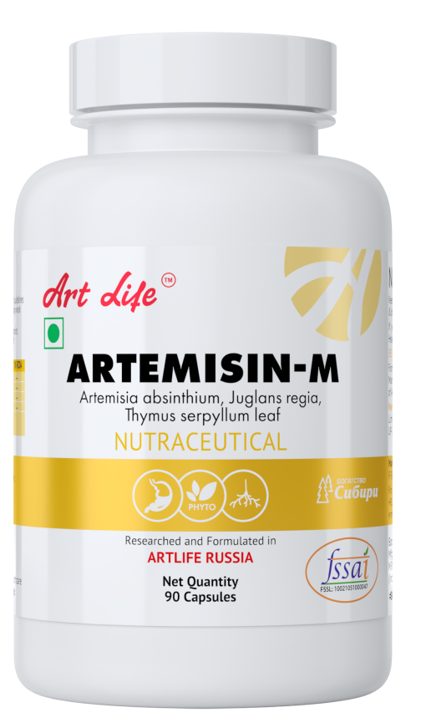
AapkI raoga–p`itkar p`NaalaI zIk krnao maoM¸ Amla–xaar saMtulana samaanya banaanao maoM¸ SarIr kI safaš krnao maoM AaOr prjaIvaI raogaaoM kI raokqaama maoM AaT-laa[f ]%pad Aapko ilae maddgaar saaibat haoMgao.
SarIr kI saMpUNa-¸ vyaapk safaš saala maoM 2 baar kroMÑ
!

Slide 17
kaoiSaka kI Pyaasa bauJaaeÐ
!
panaI A%yaMt mah%vapUNa- hO – yah ek AadSa- ivalaayak hO¸ yah svaasqyap`d yaa raogap`d BaI ha sakta hO.

Slide 18
nauksaanadoh
]pyaaogaI
svacC panaI ³baaotlabaMd¸ ]balaa huAa¸ saUxma t%vaaoM sao riht¸ @laaora[D–yau>¸
pa[p–laa[na sao Aayaa huAa´¸ ASaaoiQat panaI ³nauksaanadayak rsaayanaaoM sao yau> haD- panaI´¸ saaqa hI Ìi~ma rMga evaM ip`ja,vao-iTva yau> poya BaI.
«nauksaanadoh» poya pInao sao saUxma l%vaaoM kI kmaI hao jaatI hO
AaOr kaoiSakaAaoM ka naaSa haota hO.
poya jaao AavaSyak saUxma t%va tqaa ivaTaimansa sao yau> haoM
«]pyaaogaI» poya
[lao@T/aolaa[T saMtulana ecasaI kao saamaanya banaato hOM AaOr kaoiSakaAaoM kao savaao-<ama kaya- krnao kI xamata doto hOM
!
ApnaI kaoiSakaAaoM kao jaIvana$pI jala doMÑ

Slide 19
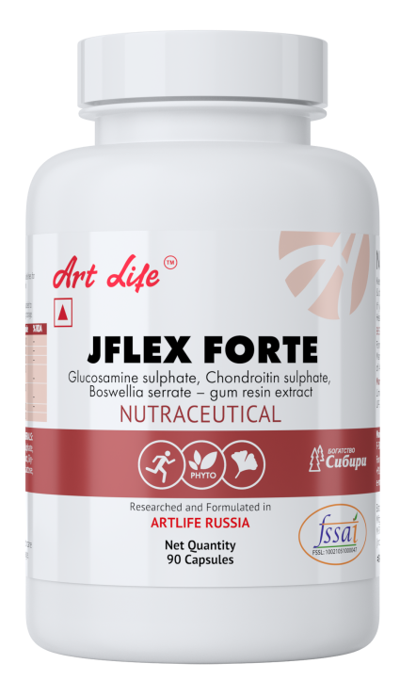
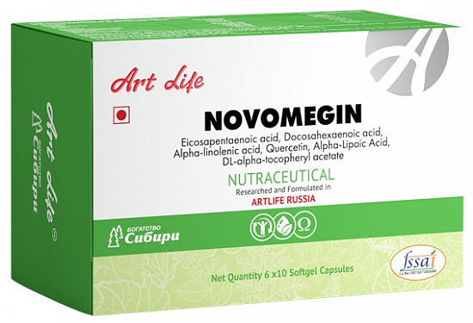
Aap tao raoja Baaojana krto hOM¸ laoikna @yaa kaoiSakaAaoM kI AavaSyakta pUNa- haotI hOÆ
?

Slide 20
3
pa^laIAnasaOcauroToD fOTI eisaD
17 eMj,aa[msa
12
ivaTaimansa
15
Kinaja
!
AaT-laa[f baayaaoka^mPlao@sa laoM — AaOr ApnaI kaoiSakaAaoM kao paoYaNa sao BarpUr Aahar doMÑ
20
eimanaao eisaD\sa

Slide 21
hmaaro raoja ko Baaojana maoM jaOivak$p sao saiËya ka^mPlao@sa @yaaoM AavaSyak hOMÆ
?
ipClao 100 vaYaao-M maoM saoba ko GaTkaoM maoM kmaI Aaš hO
laaOh – 96‰ kI
kOilSayama – 48‰ kI
maOgnaoiSayama – 83‰ kI
p<aagaaoBaI maoM paoToiSayama 58‰ kma huAa hO¸
TmaaTr maoM — kOilSayama 61‰ kma huAa hO¸
Aahar ko saaqa ]pyaaogaI baO@TIiryaa ko ]pBaaoga maoM 100 gaunaa kmaI Aaš hO.

Slide 22
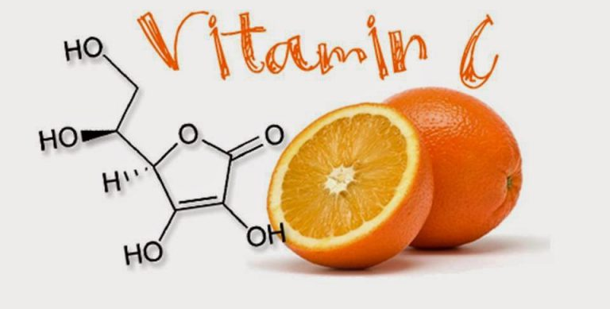
jyaadatr laaoga yah nahIM jaanato ik kovala 2 GaMTaoM ko tnaava maoM hI SarIr ka saara ivaTaimana saI ]pyaaoga kr ilayaa jaaata hO..
AaOr SarIr kao [sakI pUit- krnaa AavaSyak haota hOÑ
ivaTaimana saI Ñ
!
300 ivaiBanna kayaao-M kao saiËya krta hO

Slide 23
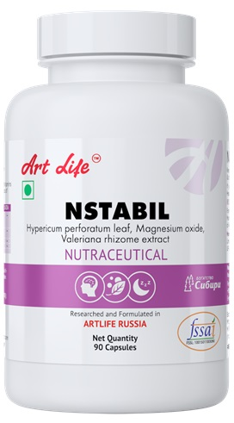
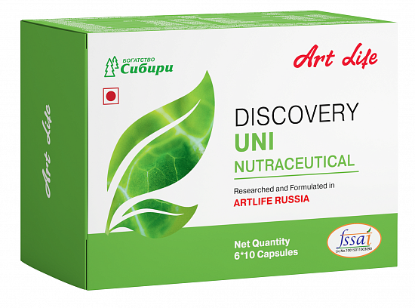
svaasqya banaae rKnao ko ilae @yaa AavaSyak hOÆ
&ana
]pkrNa
vao laaoga jaao saohtmaMd banao rhnaa caahto hOM¸ laoikna ]pcaar nahIM kranaa caahto¸ ]nako ilae AaT-laa[f kI saMBaavanaaeM tqaa saMsaaQana maaOjaUd hOM.!
!

Slide 24
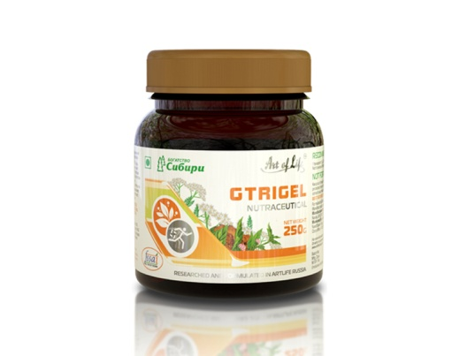
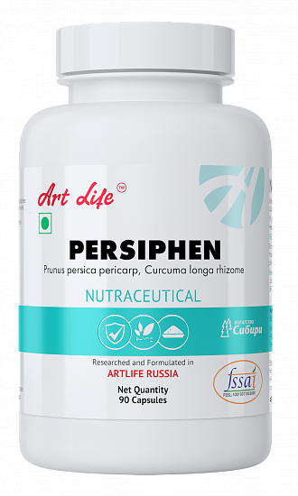
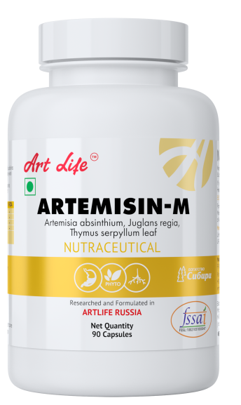
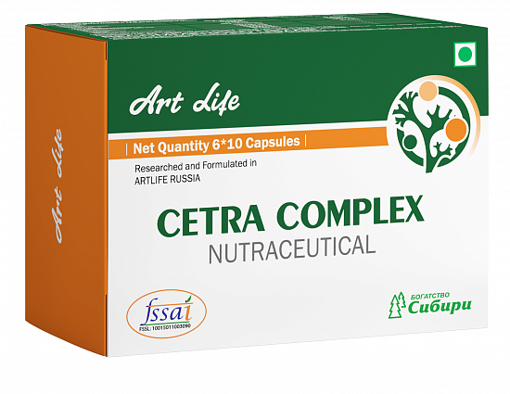
safaš kaya-Ëma ka carNa 1
AaMtaoM kI safaš
raoga–p`itkar xamata ka Sai>vaQa-na
tMi~ka p`NaalaI ka Sai>vaQa-naÑ
!
safaš kaya-Ëma ka carNa 1
TOXFIGHTER ACTIVE
NSTABIL
ARTEMIZIN-M
PERSHIPHEN
GTRIGEL
safaš ka kaya-Ëma saala maoM kma sao kma 1 yaa 2 baar ikyaa jaanaa caaihe

Slide 25
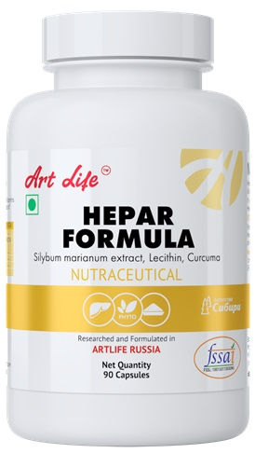
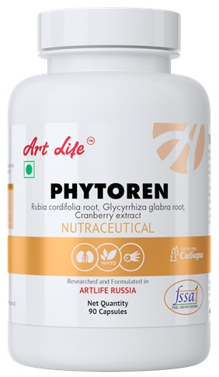
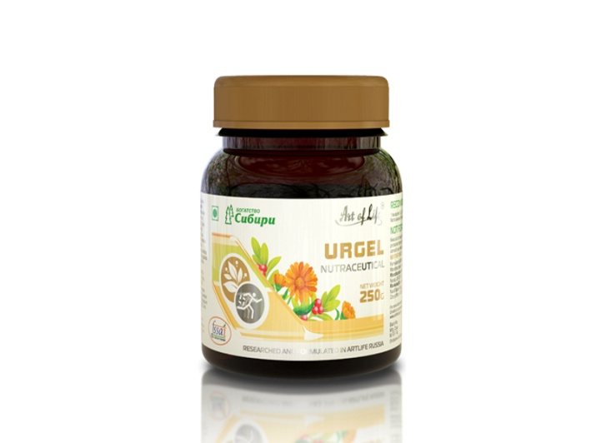
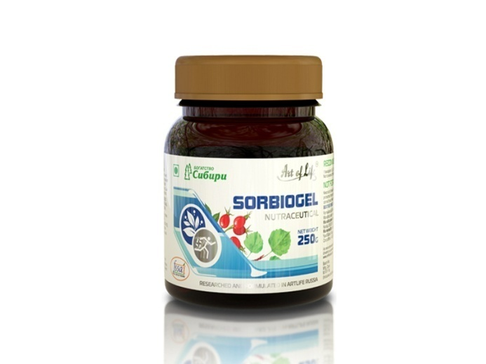
safaš kaya-Ëma ka carNa 2
laIvar AaOr ikDnaI
की safaš
!
safaš kaya-Ëma ka carNa 2
ENZYME COMPLEX PLUS
PHYTOREN
HEPAR FORMULA
UROGEL
SORBIOGEL
safaš ka kaya-Ëma saala maoM kma sao kma 1 yaa 2 baar ikyaa jaanaa caaihe.

Slide 26
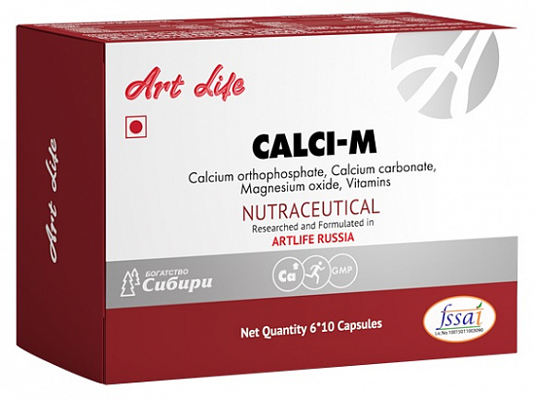
safaš kaya-Ëma ka carNa 3
paoYak t%vaaoM ko pUrk ko $p maoM saUxma jaIvaaoM kI saM#yaa baZanaaÑ
!
safaš kaya-Ëma ka carNa 3
DISCOVERY UNI
CALCI-M
ANY KIND OF KISSEL
ANY KIND OF SHAKES

Slide 27
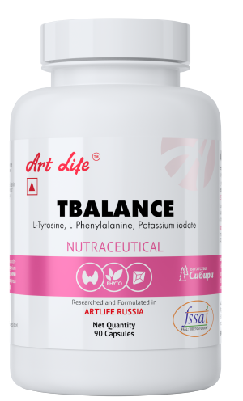
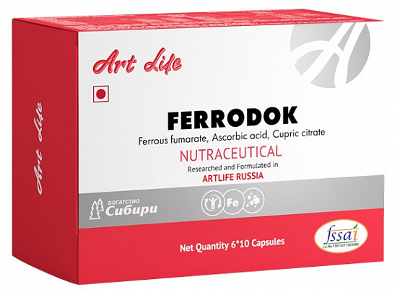
दैनिक उपयोग में आने बाले बेसिक प्रोडक्ट्स
दैनिक उपयोग
NOVOMEGIN
CALCI-M
FERRODOK
T BALANCE
GREEN STAR
!

Slide 28
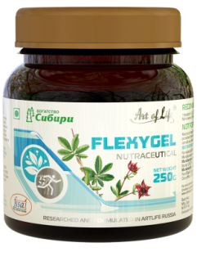
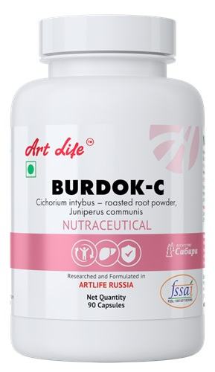
हड्डियों के मजबूती को बनाए रखने में मदद करने वाले प्रोडक्ट
दैनिक उपयोग
CALCI-M
J-FLEX FORTE
NOVOMEGIN
FLEXYGEL
Aitir> ]%pad
ENZYME COMPLEX PLUS
WOMEN’S FORMULA
BURDOK-C
NATURASEPT JOINT FLEX GEL
Ñ
!

Slide 29
raoga–p`itrxaa p`NaalaI saMvaQa-k Ñ
raoga–p`itrxaa p`NaalaI saMvaQa-k
CETRA COMPLEX
GREEN STAR
PULMOCLINZ
PERSIPHEN
SUPER SHEILD ACTIVE
!

Slide 30
eNDaoËa[na p`NaalaI saMvaQa-k
eNDaoËa[na p`NaalaI saMvaQa-k
!
PERSIPHEN
GLUCOSIL NORMA
TBALANCE
WOMEN’S FORMULA
GREEN STAR

Slide 31
AaT-laa[f ko saaqa saoht paeÐ AaOr jaIvana ka Aanand laoM Ñ
!
नोट:- इन उत्पादों का उद्देश्य किसी बीमारी का निदान, उपचार, इलाज या रोकथाम नहीं है।
ये उत्पाद कोई दवा नहीं है ..

